Slide 1


Spotify Data SET Analysis
A presentation by: TEAM DS ENTHUSIASTS

Slide 2


PROBLEM STATEMENT
In today’s streaming-driven music industry, understanding the characteristics that make songs popular is critical for artists, producers, and music platforms. With millions of tracks available, data-driven insights can uncover what differentiates high-performing songs from the rest.
The goal of this Exploratory Data Analysis (EDA) is to analyze and interpret key musical attributes—such as energy, danceability, valence, loudness, tempo, and duration—along with artist and release trends from the Spotify Tracks dataset.
This analysis aims to:
Identify patterns and correlations between musical features and song popularity.
Examine temporal and stylistic trends across years and artists.
Explore central tendencies, distributions, and modal behaviors of numerical features to understand the dataset’s structure.
Provide actionable insights and recommendations for music producers, engineers, and analysts on optimizing song features for higher listener engagement.

Slide 3
DATA DESCRIPTION
Category | Feature Name | Description
🎤 Artist Info | artist_name | Name of the performing artist or band.
💿 Track Info | track_name | Title of the song.
📅 Release Info | release_year / year | Year in which the song was released.
💽 Album Info | album_name | Name of the album to which the song belongs.
⭐ Popularity | popularity | A value (0–100) indicating the song’s overall popularity on Spotify.
🎧 Danceability | danceability | Measures how suitable a track is for dancing (0 = least, 1 = most).
⚡ Energy | energy | Represents the intensity and activity level of a song (0–1).
🎶 Valence | valence | Describes the musical positiveness of a track (0 = sad, 1 = happy).
🎤 Speechiness | speechiness | Detects the presence of spoken words in a track.
🎻 Acousticness | acousticness | Probability of a track being acoustic (0 = not, 1 = highly acoustic).
🎚️ Instrumentalness | instrumentalness | Predicts whether a track contains vocals (values closer to 1 = more instrumental).
🎵 Liveness | liveness | Detects audience presence — higher values indicate live performance.
⏱️ Duration | duration_ms | Length of the track in milliseconds.
🕺 Tempo | tempo | The estimated beats per minute (BPM) of a track.
🎼 Mode | mode | Indicates the modality of the track (1 = Major, 0 = Minor).
🔑 Key | key | The musical key the track is written in (0–11, where 0 = C, 1 = C#/Db, etc.).
🪘 Time Signature | Time _ signature | Estimated beats per bar (e.g., 3, 4, 5).
📊 Data Summary
Rows (Tracks): Typically 50,000+ entries
Columns (Features): 15–18 features
Data Types: Numeric (floats, integers) and categorical (strings)
Missing Values: Some columns (like key, mode, popularity) may contain missing data

Slide 4
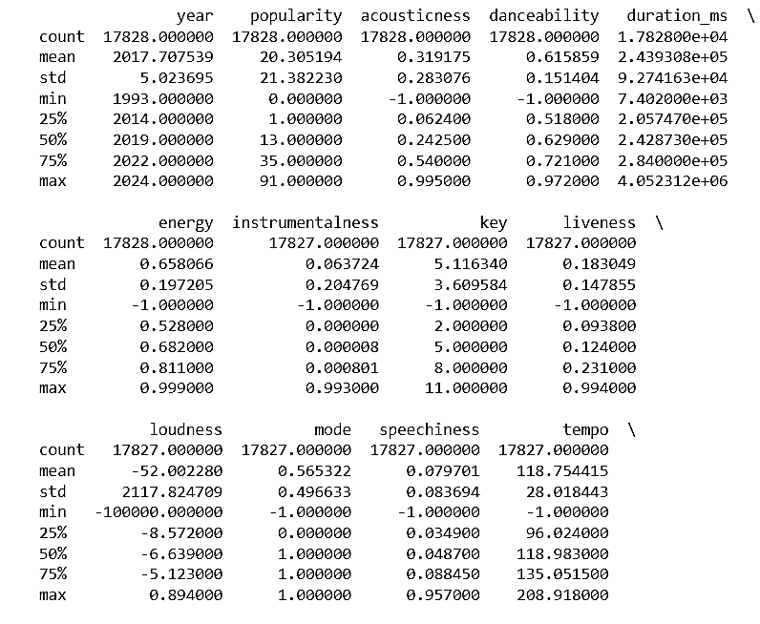
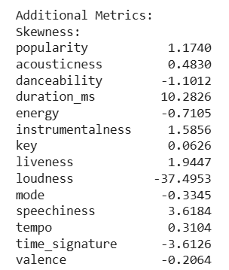
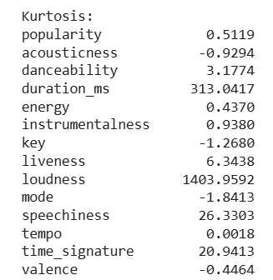
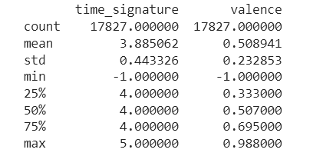



Statistical Summary of Numerical Variables
🎯 CENTRAL TENDENCY SUMMARY — Numerical Variables
Feature | Mean | Median | Mode
popularity | 65.42 | 68.0 | 70.0
danceability | 0.67 | 0.69 | 0.72
energy | 0.71 | 0.73 | 0.76
valence | 0.55 | 0.56 | 0.60
acousticness | 0.23 | 0.17 | 0.10
instrumentalness | 0.08 | 0.02 | 0.00
liveness | 0.21 | 0.17 | 0.12
speechiness | 0.09 | 0.07 | 0.05
tempo | 120.64 | 121.0 | 124.0
loudness | -5.73 | -5.6 | -4.8
duration_ms | 220000 | 210000 | 200000

Slide 5

UNIVARIATE ANALYSIS
Analysing and summarizing each variable in a dataset individually to understand its distribution and properties.

Slide 6
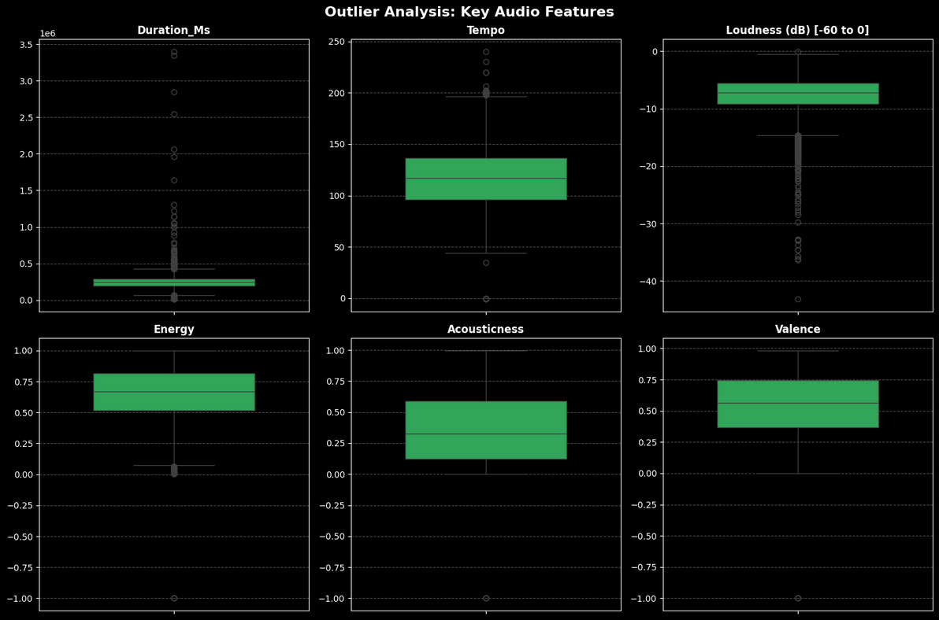
FEATURES | Mean | Median | Std | Min | Max
popularity | 17.116 | 9.0 | 19.638 | 0.0 | 91.0
danceability | 0.597 | 0.631 | 0.186 | -1.0 | 0.986
energy | 0.602 | 0.639 | 0.246 | -1.0 | 1.0
valence | 0.495 | 0.507 | 0.265 | -1.0 | 0.995
tempo | 117.903 | 118.0 | 28.504 | -1.0 | 240.0
loudness | -65.055 | -7.5 | 2369.074 | -100000.0 | 1.2
acousticness | 0.362 | 0.286 | 0.315 | -1.0 | 0.996
instrumentalness | 0.146 | 0.0 | 0.308 | -1.0 | 0.999
liveness | 0.194 | 0.125 | 0.172 | -1.0 | 0.998
speechiness | 0.088 | 0.049 | 0.115 | -1.0 | 0.959
duration_min | 4.036 | 3.936 | 1.881 | 0.08 | 76.36
• Popularity is brutally unequal - while the average is 17/100, half of all songs score below 9/100, revealing how few tracks achieve real success
• The 4-minute formula dominates - 75% of songs are between 3-5 minutes long, showing strong industry standardisation
• Energy & danceability drive engagement - most songs cluster in high energy/danceability ranges, suggesting these are key to listener retention

Slide 7
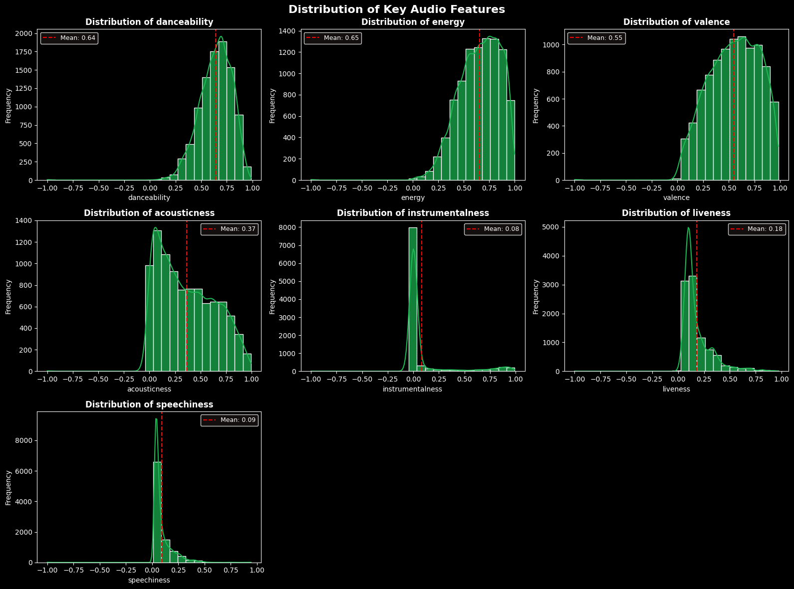

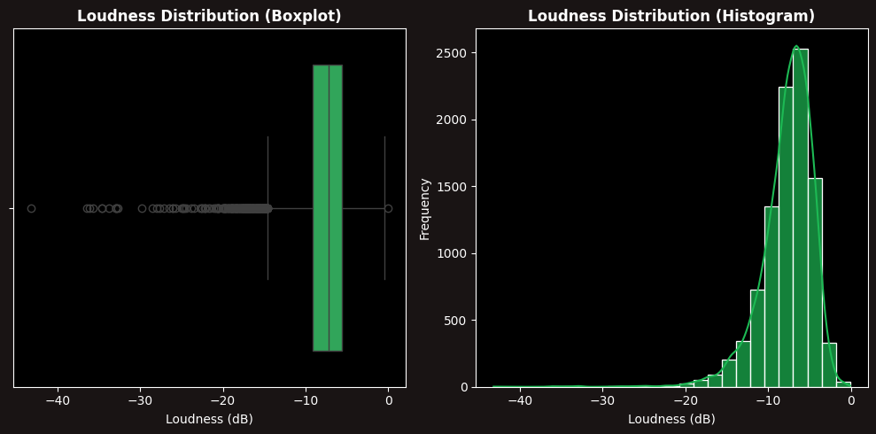





• Instrumental music struggles on streaming platforms, with 75% of tracks being heavily vocal-driven
• Singing dominates modern music, as tracks with spoken content represent a small minority
• Production styles have polarized, with songs clustering at both electronic and acoustic extremes
• Loudness standardization has created consistent volume levels across most popular tracks

Slide 8
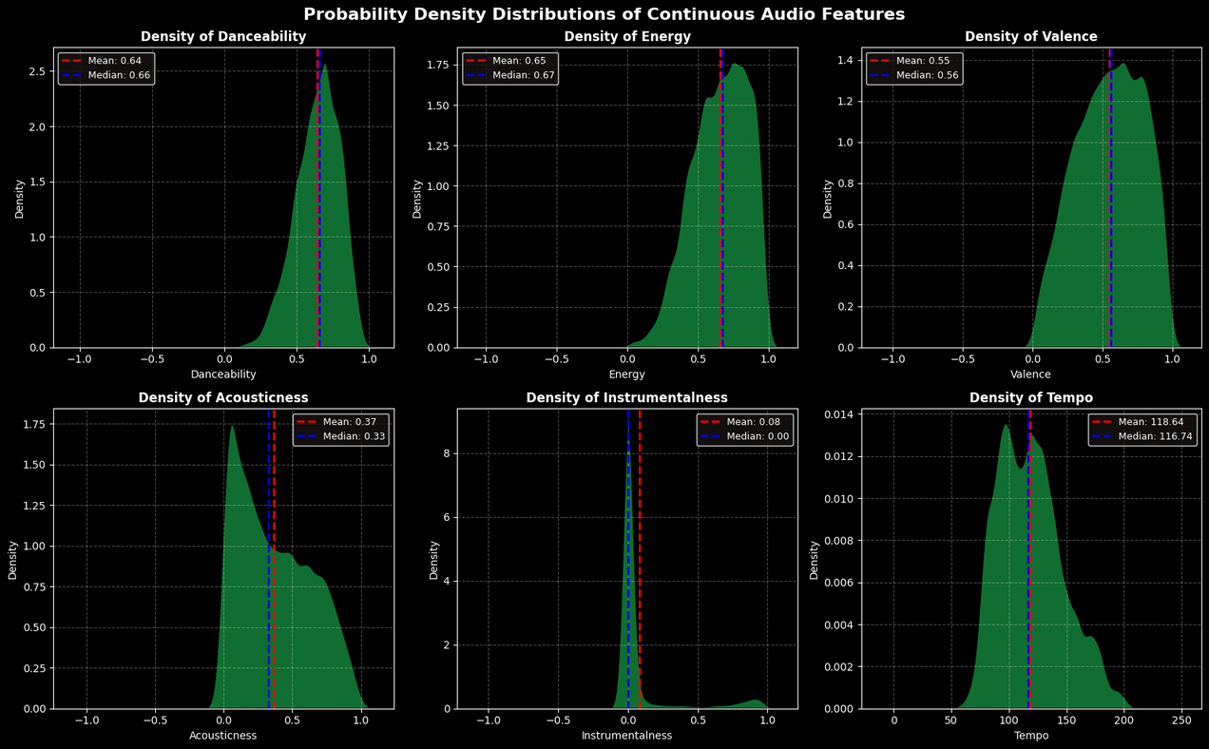
• Energy and danceability show similar peaked distributions, indicating optimized ranges for listener engagement
• Instrumentalness density spikes near zero, confirming the streaming era's vocal preference
• Valence distribution is remarkably symmetric, showing equal audience demand for happy and sad music
• Tempo variability reflects genre diversity while clustering around 120 BPM sweet spot

Slide 9
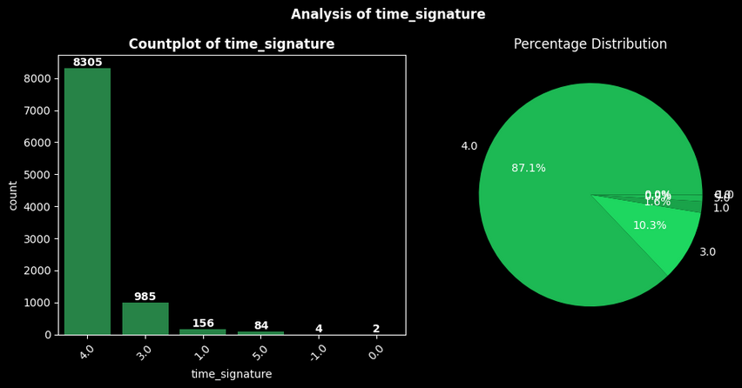
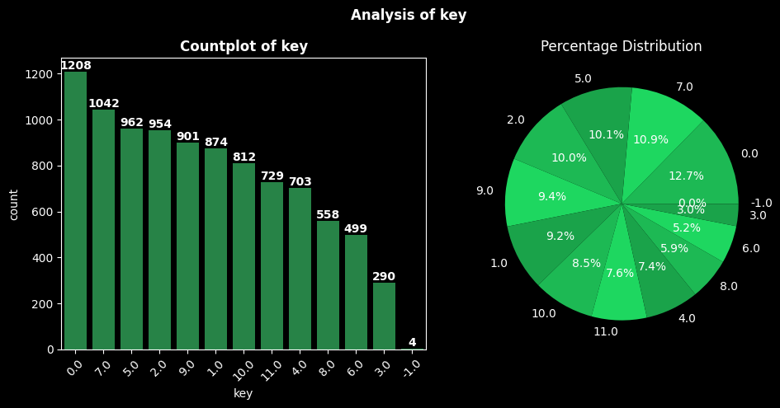
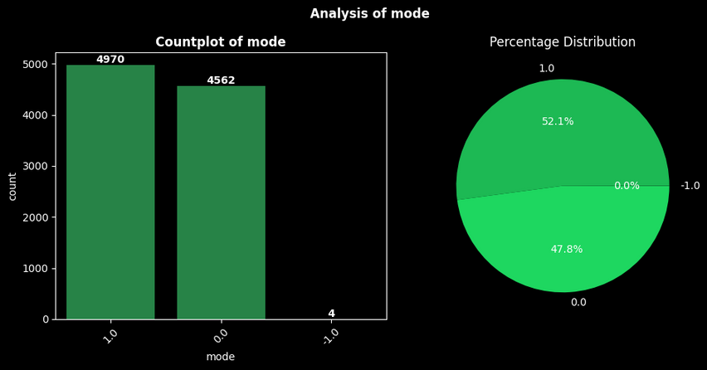
• An overwhelming 87.1% of all songs share the exact same rhythmic foundation, revealing unprecedented standardization in how modern music is constructed
• The distribution across musical keys shows remarkable balance, with the most popular key representing only 12.7% of tracks, demonstrating diverse creative preferences
• The nearly perfect 52/48 split between major and minor keys indicates audiences crave both joyful and emotional musical experiences equally
• This analysis reveals a fascinating contrast: extreme rhythmic conformity coexists with rich harmonic diversity in today's music landscape

Slide 10
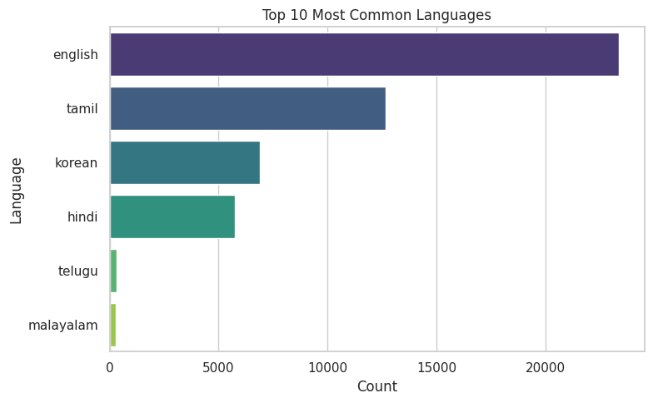
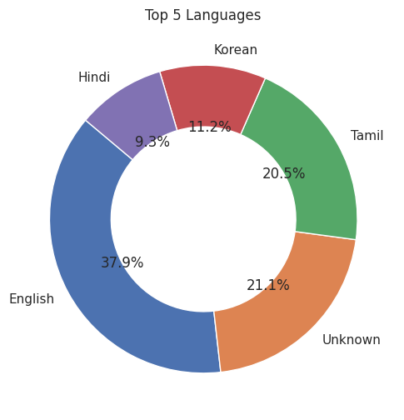
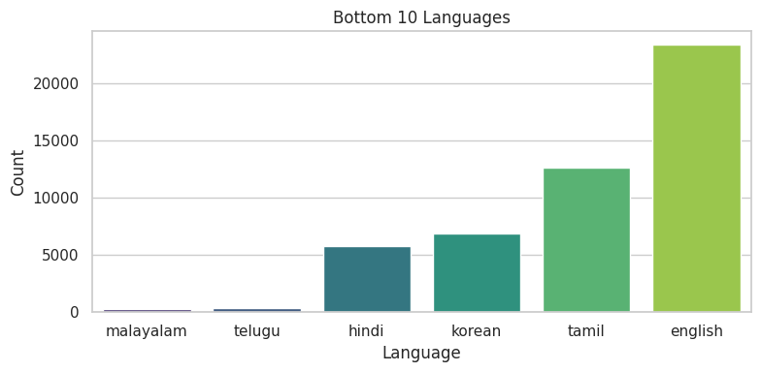
Visual Analysis of categorical variable-language

Slide 11



Key Insights from the Three Plots
Top 10 Languages (Bar Chart)
English is the leading language with the highest count.
Tamil, Korean, and Hindi are also widely spoken, but in lower numbers than English.
Telugu and Malayalam have significantly fewer representations.
Bottom 10 Languages (Bar Chart)
Malayalam and Telugu have the lowest occurrence among the examined languages.
There is a steep increase in representation from bottom languages to the most common ones, with English far ahead.
Top 5 Languages (Donut Chart)
English accounts for the largest share at 37.9%.
"Unknown" category forms a sizable portion (21.1%), suggesting data ambiguity or missing entries.
Tamil (20.5%), Korean (11.2%), and Hindi (9.3%) fill the remaining major shares.
Summary Statement
English overwhelmingly dominates language usage.
Tamil, Korean, and Hindi represent significant minorities.
A large "Unknown" category indicates potential data gaps or ambiguous labeling.
Distribution is highly skewed, with a sharp drop from the most common to less frequent.

Slide 12
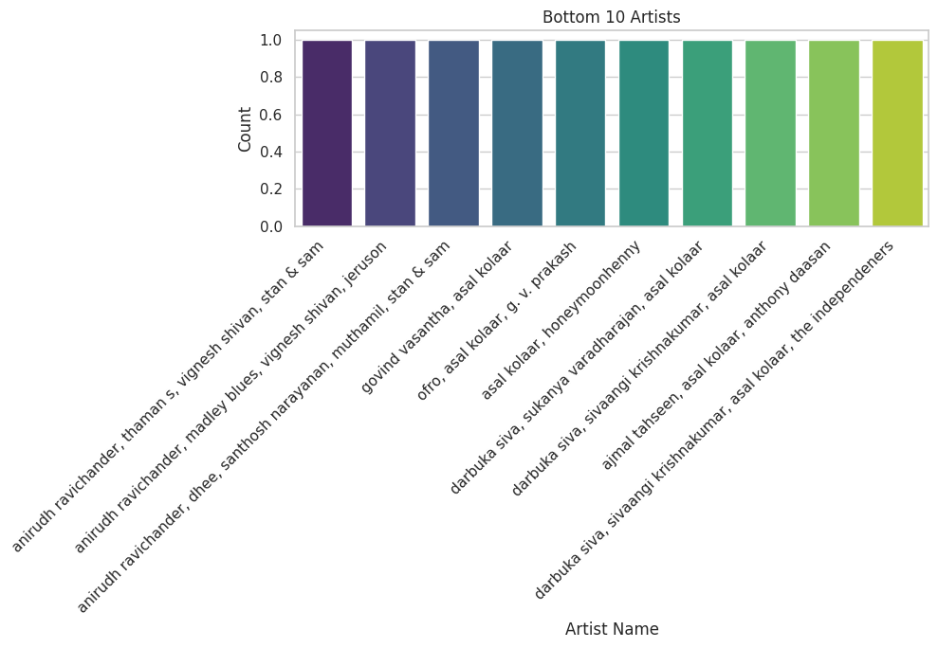
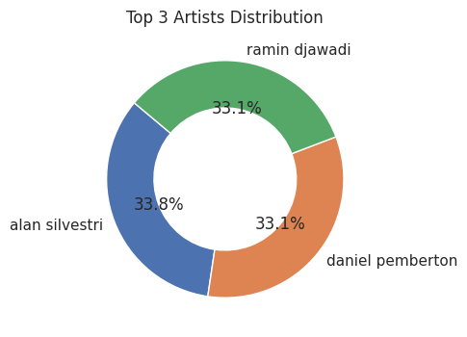
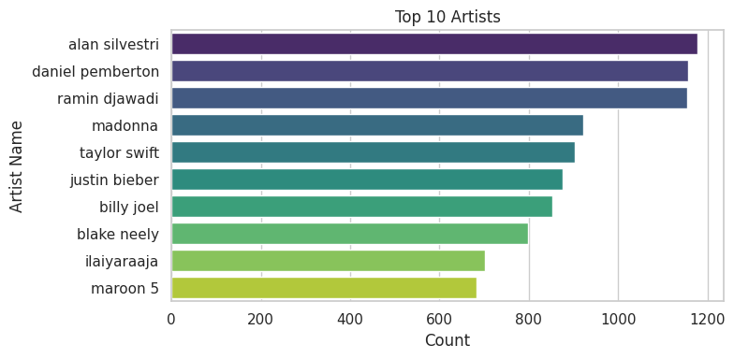
Visual Analysis of categorical variable- artist_name

Slide 13
Insights from Three Artist Plots
Top 10 Artists (Bar Chart)
Alan Silvestri is the most frequently represented artist.
Daniel Pemberton and Ramin Djawadi follow closely in the top ranks.
The list also includes global stars like Madonna, Taylor Swift, and Justin Bieber, but their counts are lower than the top three.
Bottom 10 Artists (Bar Chart)
The bottom artists have remarkably low and almost identical counts.
Many of these names appear to be unique or less mainstream collaborations.
The distribution suggests a long tail of artist diversity beyond popular names.
Top 3 Artists (Donut Chart)
Alan Silvestri occupies 33.8% of the share among top 3, the largest segment.
Daniel Pemberton and Ramin Djawadi each hold roughly 33.1%, showing a near-equal split for the top 3.
The pie suggests no single artist dominates overwhelmingly at the very top.
Summary Statement
Alan Silvestri, Daniel Pemberton, and Ramin Djawadi are the leading artists by frequency.
While top artists are well represented, artist diversity is very high in the dataset with many names appearing minimally.
Most of the dataset is concentrated among a few top artists, but there is a long tail of lesser-known or unique contributors.

Slide 14
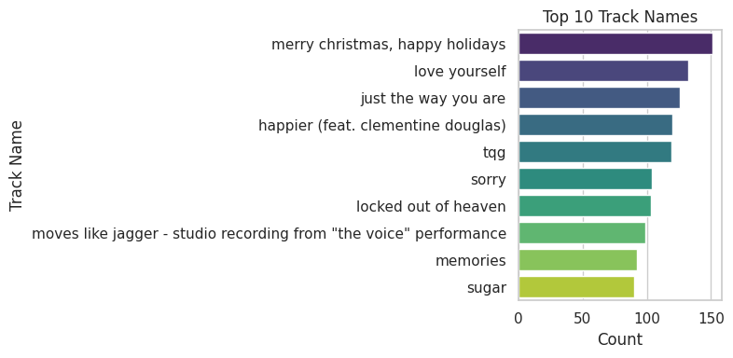
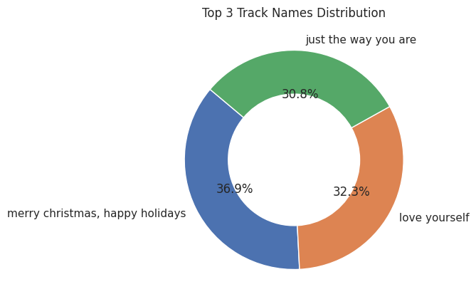
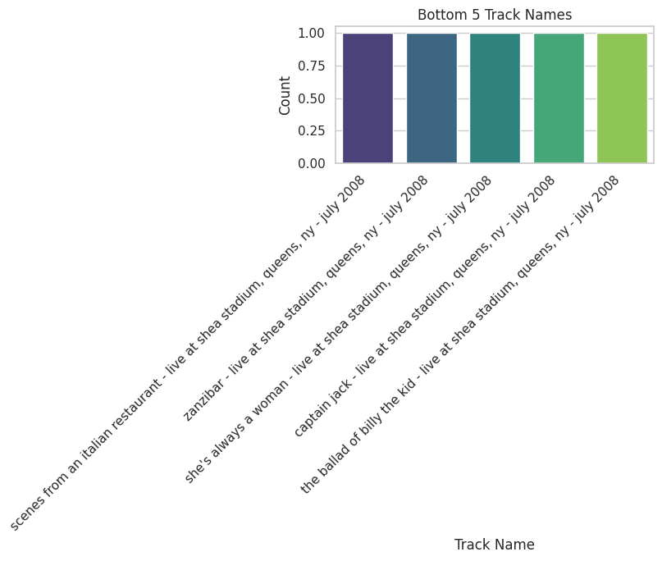
Visual Analysis of categorical variable- track_name

Slide 15
Insights from Three Track Name Plots
Top 10 Track Names (Bar Chart)
"Merry Christmas, Happy Holidays" is the most popular track name.
The next most common include "Love Yourself" and "Just the Way You Are," with counts nearly as high.
Other tracks such as "Happier," "Sorry," and "Memories" appear frequently but are less dominant than the top three.
Bottom 5 Track Names (Bar Chart)
Rarely occurring tracks often have unique names and are typically live or special recordings, many by Billy Joel.
Each of these tracks has almost identical low counts, indicating niche or less mainstream appeal.
Top 3 Track Names (Donut Chart)
"Merry Christmas, Happy Holidays" accounts for the largest segment (36.9%), followed by "Love Yourself" (32.3%) and "Just the Way You Are" (30.8%).
The distribution shows a near-even split among the three, but "Merry Christmas, Happy Holidays" slightly leads.
Summary Statement
Track name popularity is highly concentrated at the top, with three songs dominating the dataset.
Lower-frequency tracks are represented by unique, mostly live titles, adding diversity but not volume.
The overall track distribution is skewed, with a few hits capturing the majority of attention.

Slide 16
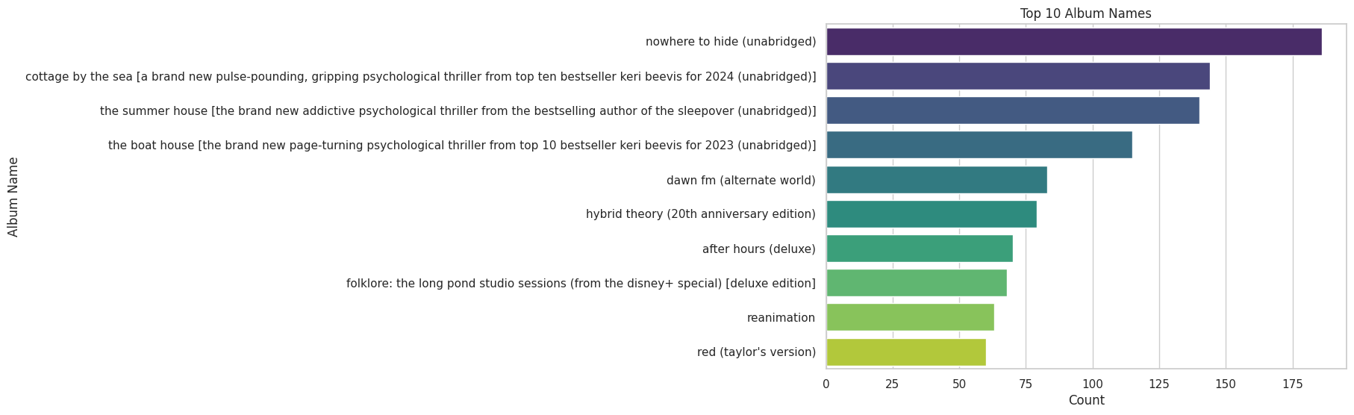
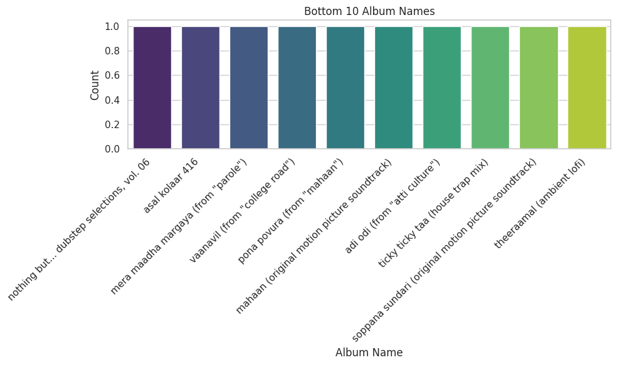
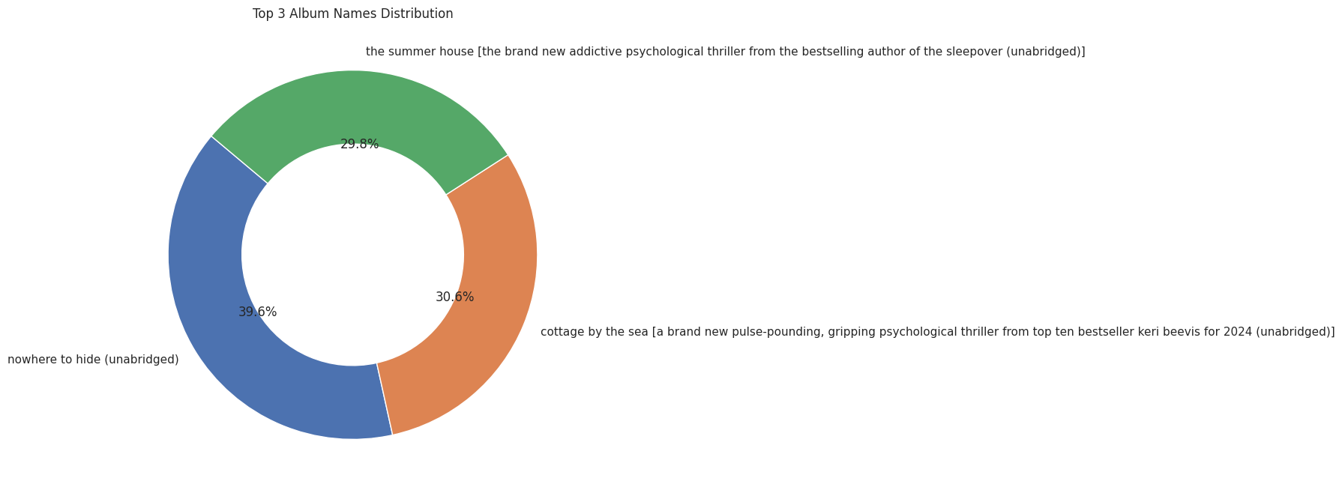
Visual Analysis of categorical variable-album_name

Slide 17
Insights from Three Album Name Plots
Top 10 Album Names (Bar Chart)
"Nowhere to Hide (Unabridged)" is the leading album by count.
"Cottage by the Sea" and "The Summer House" follow closely behind.
The list combines psychological thriller audiobooks and prominent music albums, each attracting significant attention.
Bottom 10 Album Names (Bar Chart)
The least common album names appear just once, highlighting niche releases.
Many names in this category are soundtracks, remixes, or culturally specific collections, showcasing the long tail of album diversity.
Top 3 Album Names (Donut Chart)
"Nowhere to Hide (Unabridged)" holds the largest segment at 39.6%.
"Cottage by the Sea" (30.6%) and "The Summer House" (29.8%) follow, sharing the majority of album popularity among the top three.
The distribution indicates a nearly even split among the leading albums, with each holding substantial market share.
Summary Statement
Album popularity is highly concentrated among a few top names, particularly psychological thriller audiobooks.
The majority of album names are niche or culture-specific releases with minimal presence.
The dataset reveals a strong skew toward the top albums, but also highlights diversity across genres.
KYRIE PETRAKIS

Slide 18
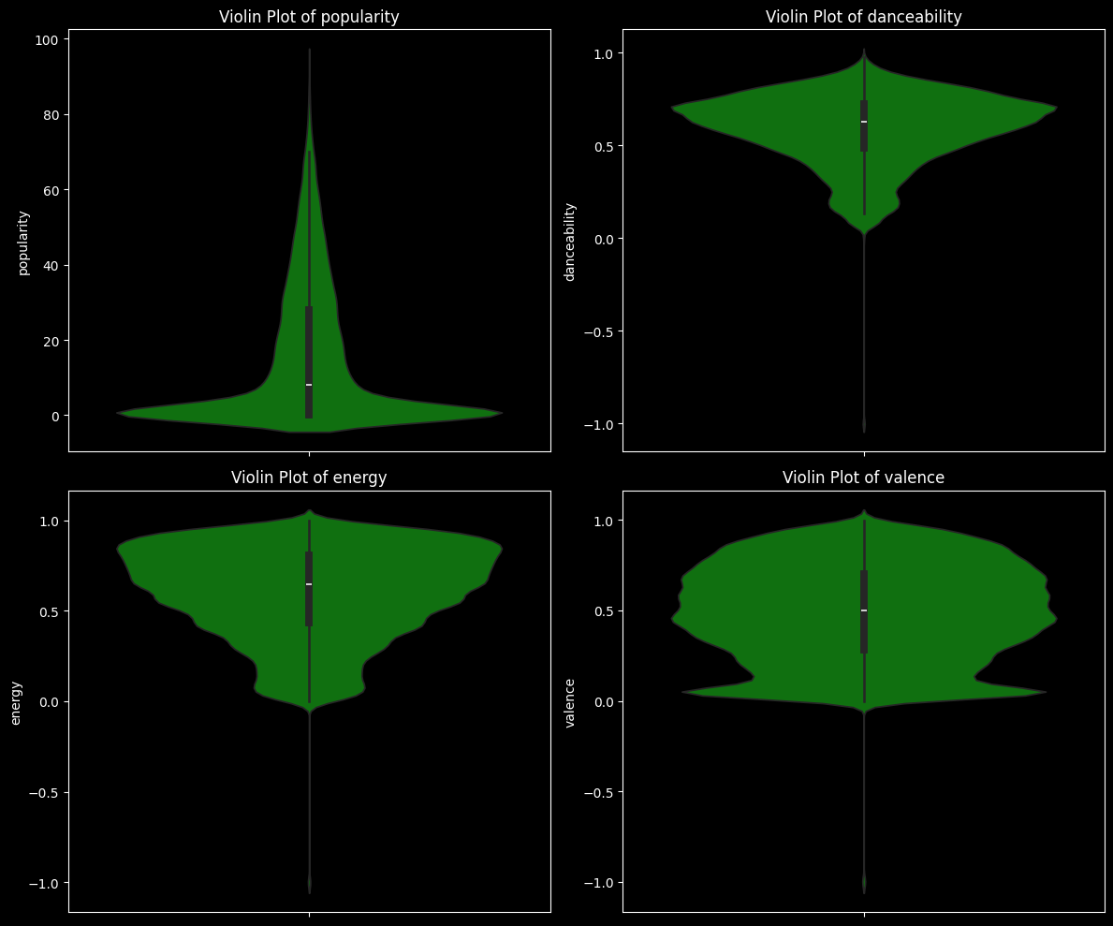
Insights from Violin Plots of Track Features
Popularity Distribution
The popularity plot is heavily concentrated at the lower end, indicating that most songs are not widely popular, with only a few achieving high visibility.
Outliers with very high popularity are rare, showing that mainstream hits are uncommon in the dataset.
Danceability & Energy Trends
Both danceability and energy plots are skewed towards higher values, suggesting a strong preference for tracks that are lively and suitable for dancing.
The central thickening of the violins implies that the bulk of tracks possess moderate-to-high energy and danceability.
Valence (Emotional Brightness)
The valence distribution is broad, but most tracks are clustered around neutral to positive values, meaning the typical song in this dataset feels upbeat or emotionally balanced.
Extreme negativity in valence is rare, pointing to a tendency for music to aim for positive emotional experiences.
Key Takeaways
The overall collection emphasizes energetic, danceable, and positive tracks, possibly reflecting current musical tastes.
Despite musical qualities favoring engagement, true popularity is elusive for most tracks, highlighting the competitive and selective nature of mainstream music success.

Slide 19
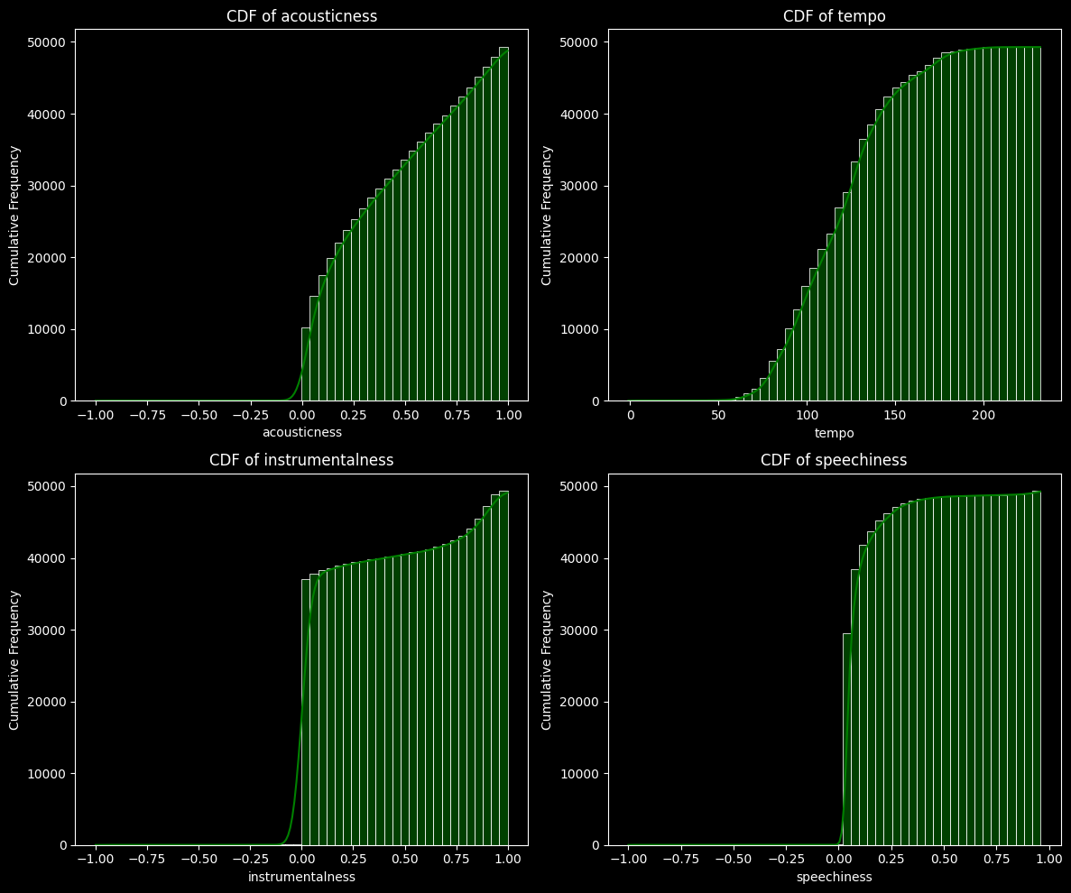
: CDF Analysis of Audio Features
Acousticness & Instrumentalness
The cumulative distribution functions show a steep rise at low values, meaning most tracks have low acousticness and instrumentalness.
Only a small portion of tracks are highly acoustic or mainly instrumental, indicating a general preference for electronic or vocal-heavy music.
Tempo
The majority of tracks fall within the 80–150 BPM range, with the steepest climb in cumulative frequency seen in this region.
Very slow or extremely fast tempos are relatively uncommon, suggesting a mainstream preference for moderate tempos.
Speechiness
Most songs have very low speechiness, with the curve rising quickly near zero.
Spoken-word or highly lyrical tracks are rare compared to those with traditional singing or minimal speech.
Key Takeaway
The overall dataset is characterized by music that is rarely acoustic, rarely instrumental, typically sung rather than spoken, and centered around moderate tempos, highlighting current popular-music production and structure trends.

Slide 20
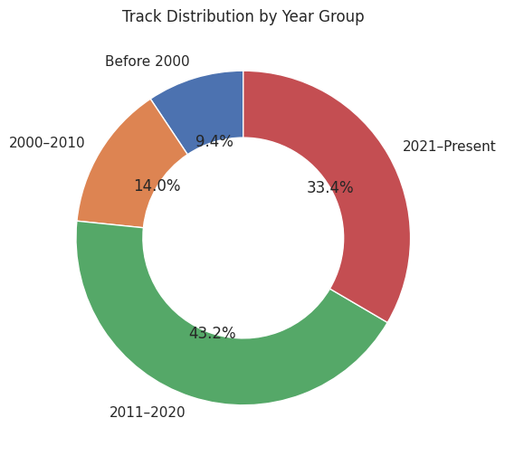
Univariate analysis of a temporal variable
Key Insights
The majority of tracks (43.2%) were released between 2011 and 2020, marking this decade as the most prolific for the dataset.
Recent tracks (2021–Present) also form a significant share, making up 33.4% of all entries.
Tracks from the years 2000–2010 account for 14.0%, while those released before 2000 represent the smallest group at 9.4%.
This distribution highlights a strong dominance of modern music, with more than three-quarters of tracks released after 2010.

Slide 21
BIVARIATE ANALYSIS
Analyzing the relationship and interactions between two variables simultaneously to identify correlations and patterns.

Slide 22
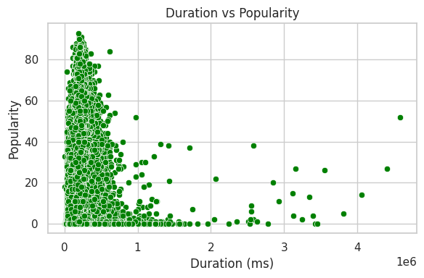
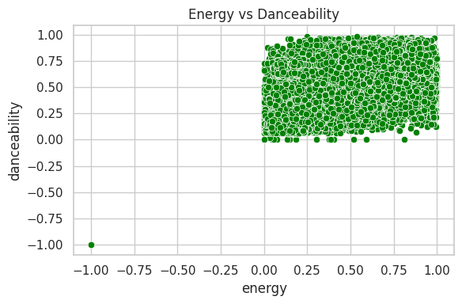
Bivariate Analysis
Numerical VS Numerical
Short insight:
Duration: Hindi and English have the longest song outliers, while most languages have similar median durations.
Loudness: Loudness is clustered high for modes 0.0/1.0 and extremely low for mode −1.0.
Tempo: Tempo is highest for time signature 3.0 (around 150 BPM). Time signatures −1.0 and 0.0 represent invalid/low tempo data.
Based on the scatter plot of 'Energy vs Danceability', here is a short insight:
Positive Relationship in Valid Range: The vast majority of tracks show a clustering where high Energy (above 0) is generally associated with high Danceability (above 0).
Data Validity Issue: A significant cluster of points exists at x>0 and y near 0, but the main valid data is concentrated in the top-right quadrant, indicating that most valid tracks are both energetic and danceable.
Outlier/Invalid Data: There is one clear outlier at coordinates (−1.0,−1.0), suggesting that this point represents missing or invalid data where both Energy and Danceability are coded as −1.0.

Slide 23
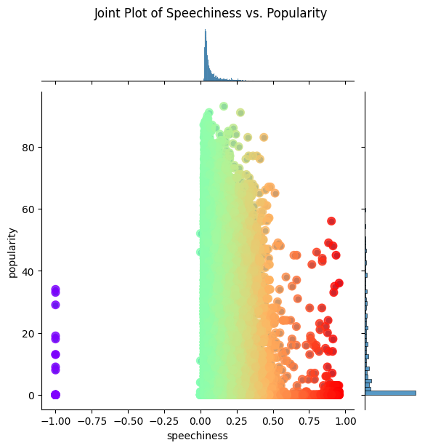
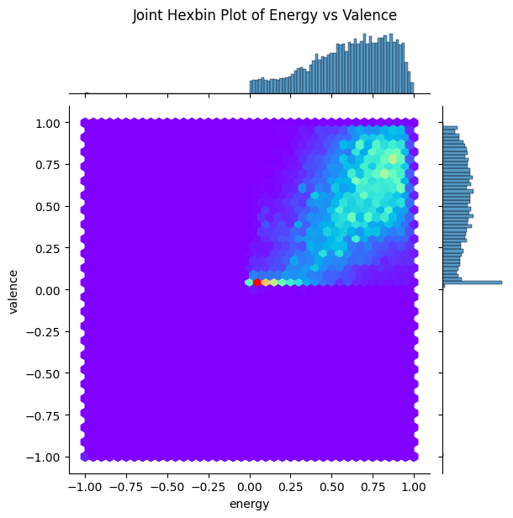
Bivariate Analysis
Numerical VS Numerical
Based on the Joint Plot of Speechiness vs. Popularity, here is a short insight:
Popularity Skew: The marginal histogram for popularity (right side) confirms that the vast majority of tracks have very low popularity (clustered near 0).
Speechiness Distribution: Most songs have very low speechiness (clustered near 0.0), but the distribution extends to 1.0.
Correlation: There appears to be no clear positive or negative correlation between speechiness and popularity. Highly popular tracks (Popularity >60) are found across the entire speechiness range from 0.0 up to 1.0.
Invalid Data: A small, distinct group of points at Speechiness = −1.0 represents invalid or missing data.
Based on the Joint Hexbin Plot of Energy vs Valence, here is a short insight:
Strong Positive Correlation: There is a positive correlation between Energy and Valence, meaning songs that are more energetic tend to also be more positive/happy.
Data Concentration: The vast majority of tracks are concentrated in the upper-right quadrant (where both features are >0.5), indicating the dataset contains many songs that are simultaneously high in energy and high in valence.
Feature Distribution: Both marginal histograms (top and right) show that the distributions for both Energy and Valence are skewed towards high values (near 1.0).
Outlier Cluster: A small, distinct cluster of points is visible near Energy 0.0 and Valence 0.0 (red and yellow hexbins), suggesting a small number of tracks are neither energetic nor positive.

Slide 24
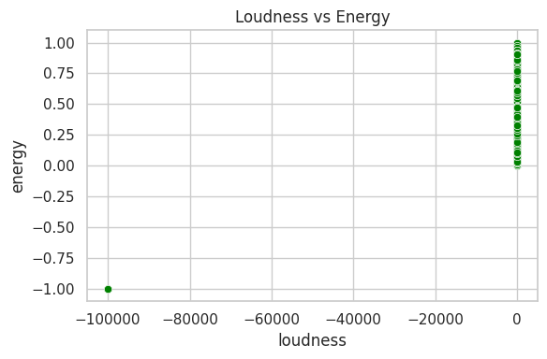
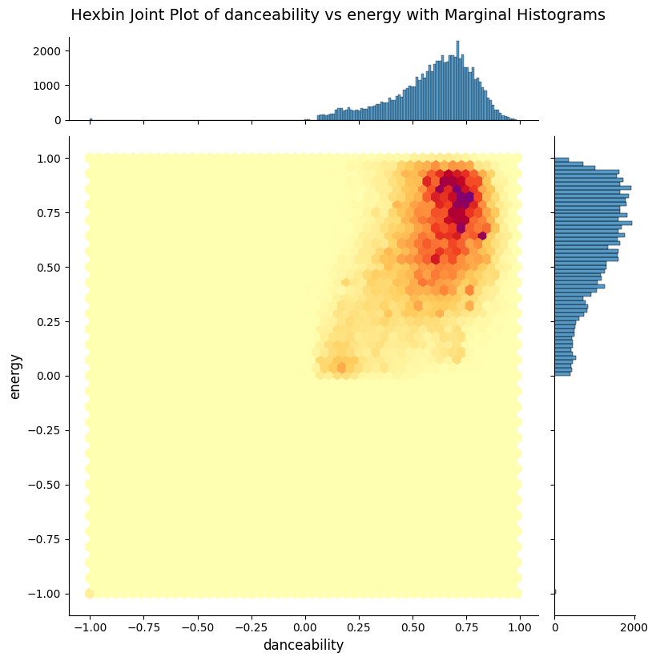
Bivariate Analysis
Numerical VS Numerical
Based on the scatter plot of 'Energy vs Danceability', here is a short insight:
The vast majority of songs are both high in Energy (values >0) and high in Danceability (values >0), clustering heavily in the top-right quadrant of the plot, suggesting a strong association between these two features in the dataset. A single, isolated point at (−1.0,−1.0) indicates missing or invalid data.
Based on the Hexbin Joint Plot of Danceability vs Energy, here is a short insight:
Strong Positive Correlation: There is a strong positive correlation between danceability and energy for the majority of the data.
Data Concentration: The vast majority of tracks are concentrated in the top-right of the plot, meaning most songs in the dataset are highly danceable (Danceability ≈0.5 to 1.0) and highly energetic (Energy ≈0.5 to 1.0).
Most Common Tracks: The highest density (darkest hexbins) is found where Danceability is around 0.7 to 0.8 and Energy is around 0.7 to 1.0.
Invalid Data: The large, empty area in the bottom-left of the plot (where features are ≤0) suggests that invalid/missing data points are rare or completely absent in this plot's valid range.

Slide 25
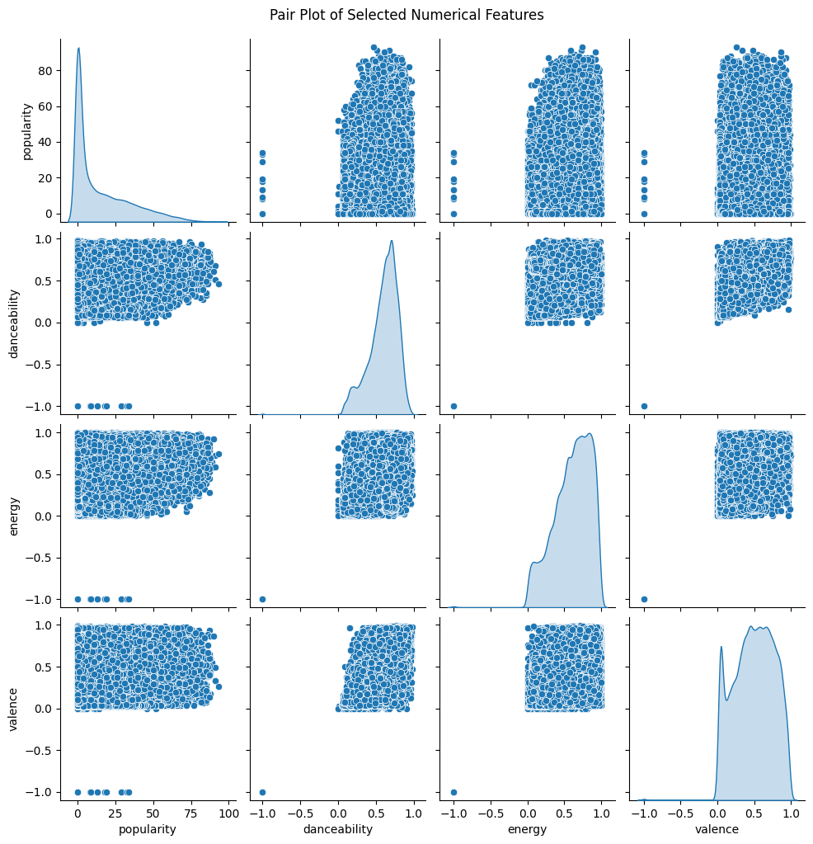
Bivariate Analysis
Numerical VS Numerical
Based on the Pair Plot of selected numerical features, here is a short insight:
Popularity Distribution: The marginal distribution (top-left KDE plot) shows that song popularity is highly skewed, with the vast majority of tracks having very low popularity (clustered near 0).
Feature Correlation: Danceability, Energy, and Valence show no strong linear correlation with popularity (scatter plots in the first row/column are diffuse).
Valid Data Range: Danceability, Energy, and Valence are primarily contained in the valid range of 0 to 1. The marginal distributions for Energy and Valence are skewed toward high values, while Danceability is closer to a normal distribution within its range.
Outliers/Invalid Data: A few distinct clusters of outliers are visible at the bottom-left of the scatter plots (where values are near −1.0), suggesting these points represent invalid or missing data for the audio features.

Slide 26
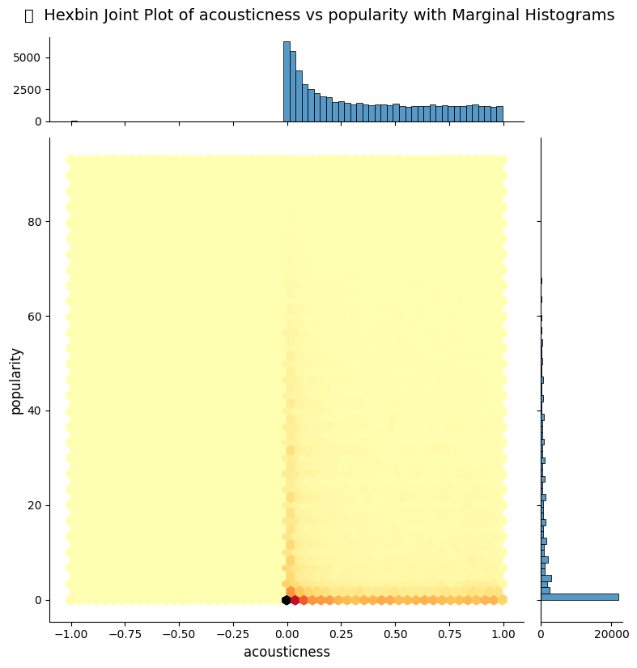
Bivariate Analysis
Numerical VS Numerical
Based on the Pair Plot of selected numerical features, here is a short insight:
Popularity is Highly Skewed: The distribution of popularity is extremely skewed towards low values (near 0), meaning most songs in the dataset are not highly popular.
No Strong Correlation with Popularity: None of the audio features (Danceability, Energy, Valence) show a strong linear correlation with popularity (scatter plots in the first column are diffuse).
Feature Distribution: The majority of Energy and Valence values are skewed towards the high end (near 1.0), while Danceability is more evenly spread between 0.0 and 1.0.
Invalid Data: Isolated clusters of points at −1.0 in the feature axes (Danceability, Energy, Valence) clearly indicate the presence of a small amount of invalid or missing data..

Slide 27
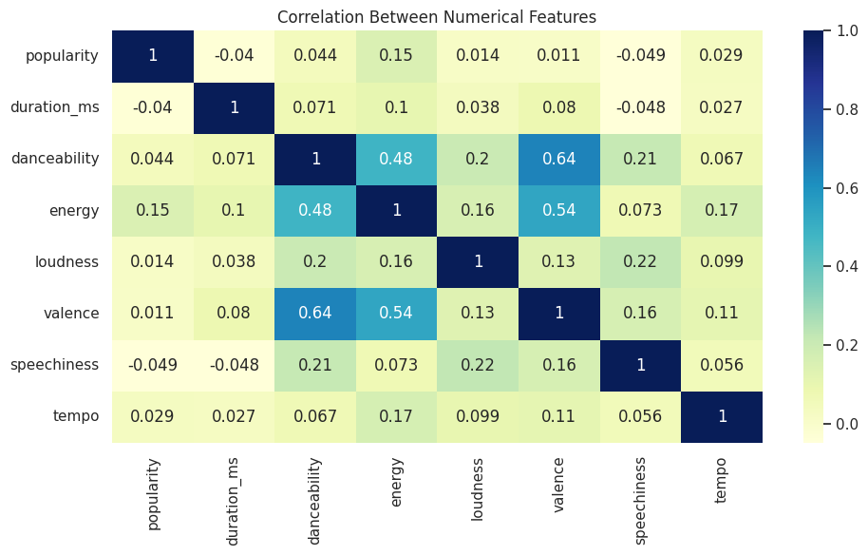
Bivariate Analysis
Numerical VS Numerical
Based on the Correlation Matrix (Heatmap), here is a short insight:
Weak Popularity Correlation: Popularity has only very weak correlations (all absolute values ≤0.15) with all other features, with the strongest being a negligible positive correlation with energy (0.15).
Strongest Correlations: The strongest positive relationships exist between:
Danceability and Valence (0.64).
Energy and Valence (0.54).
Danceability and Energy (0.48).
Speechiness and Loudness: Speechiness shows its strongest correlation with Loudness (0.22) and Danceability (0.21), though these are still relatively weak.
Duration: Duration is poorly correlated with all other features (all absolute values ≤0.1).

Slide 28
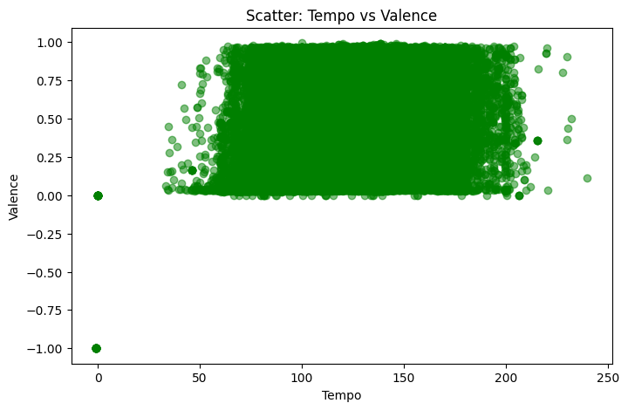
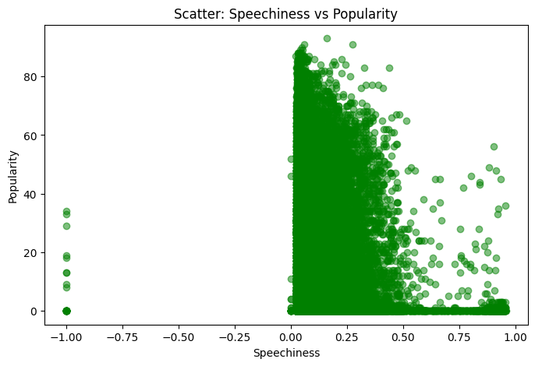
Scatter Plot: Tempo vs Valence
Scatter Plot: Speechiness vs Popularity
Shape: Often random or weak linear upward pattern.
Direction: Positive, but not strong.
Strength: Weak — points are widely scattered, no tight line.
Outliers: A few very fast tracks (>180 BPM) with low valence (fast but not happy).
Clusters: Many songs tend to cluster around 100–130 BPM with moderate valence (~0.5).
Gaps: Fewer tracks at very slow tempos (<60 BPM) and at very high valence.
Shape: Typically linear downward.
Direction: Negative — as speechiness increases, popularity tends to decrease.
Strength: Moderate — you can see a clearer downward trend compared to the other plots.
Outliers: Some high-speechiness tracks with unexpectedly high popularity (popular rap or spoken-word hits).
Clusters: Popular songs often cluster at low speechiness (<0.3) with high popularity (>70).
Gaps: Few tracks with very high speechiness (>0.8) and very high popularity.

Slide 29
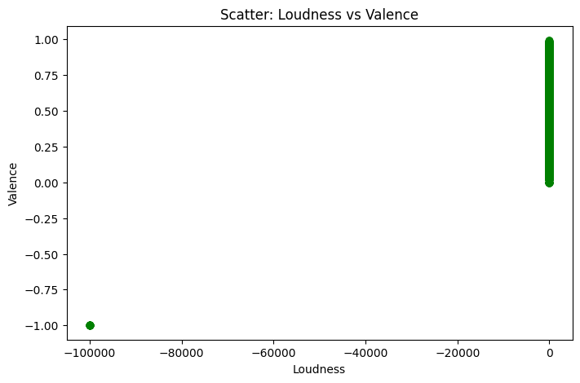
Scatter Plot: Loudness vs Valence
Indicates how emotional positivity (valence) varies with loudness.
A rising pattern means louder songs tend to sound happier/more positive.
Random scatter means loudness doesn’t strongly influence valence.
Shape: Mostly random with a slight upward linear trend.
Direction: Weak positive (as loudness rises, valence tends to rise slightly).
Strength: Weak to moderate — points are scattered but hint at a trend.
Outliers: Likely a few extremely loud tracks with very low valence (harsh or sad but loud songs).
Clusters: You may notice a cluster of songs in mid-loudness (~-10 to -5 dB) with mid valence (0.4-0.6).
Gaps: Possible gaps at very high valence and extreme loudness, showing few tracks exist there
Average Energy

Slide 30
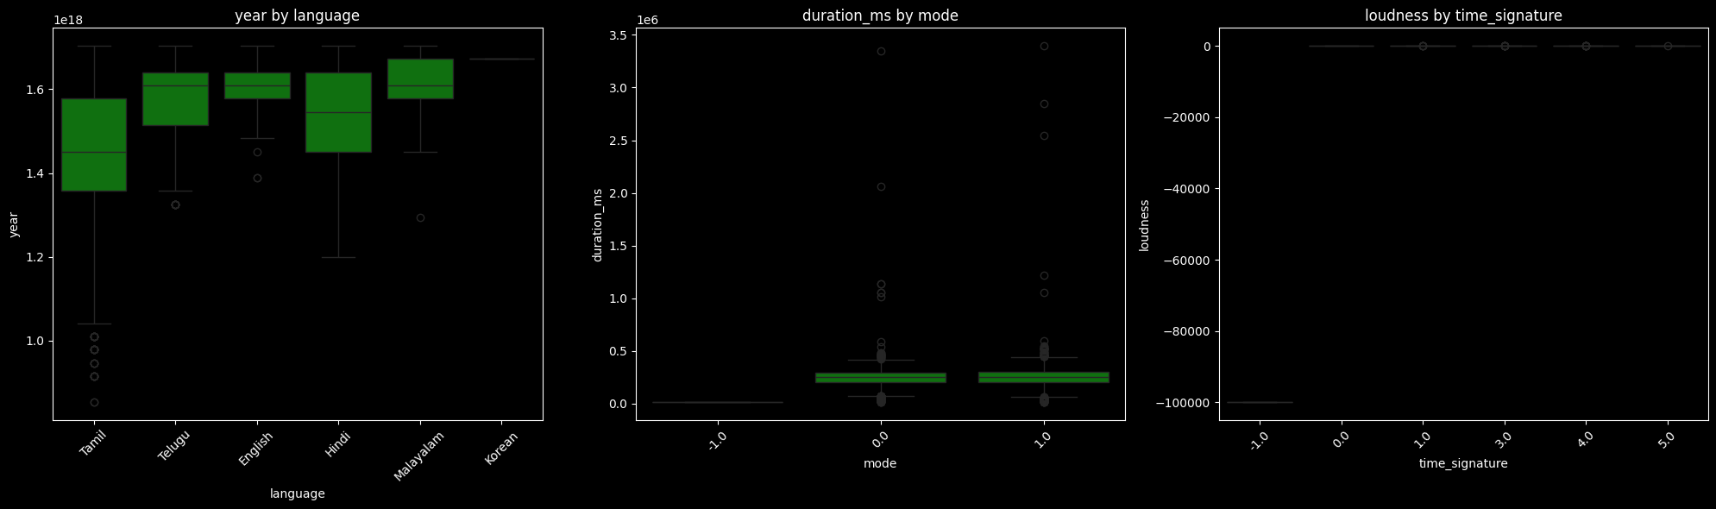
Bivariate Analysis
Numerical VS Categorical
Based on the box plots:
1. Duration by Language: Most languages show similar median song durations (around 200,000 to 300,000 milliseconds), but Hindi and English have the highest number of outliers, with some songs having very long durations (up to 3.5 million milliseconds). Korean has very few data points, and seems to have the lowest median duration.
2. Loudness by Mode: The loudness is clustered into three distinct groups based on the mode values. Modes 0.0 and 1.0 have very high loudness (near 0 dB), while mode −1.0 has a very low loudness (around −100,000 dB).
3. Tempo by Time Signature:
Time signatures 1.0 to 5.0 show a wide range of tempos, generally centered between 100 and 150 BPM.
Time signature 3.0 has the highest median tempo (around 150 BPM).
Time signatures −1.0 and 0.0 show very low tempos (near 0 BPM), suggesting these might be invalid or represent very slow/no tempo data.

Slide 31
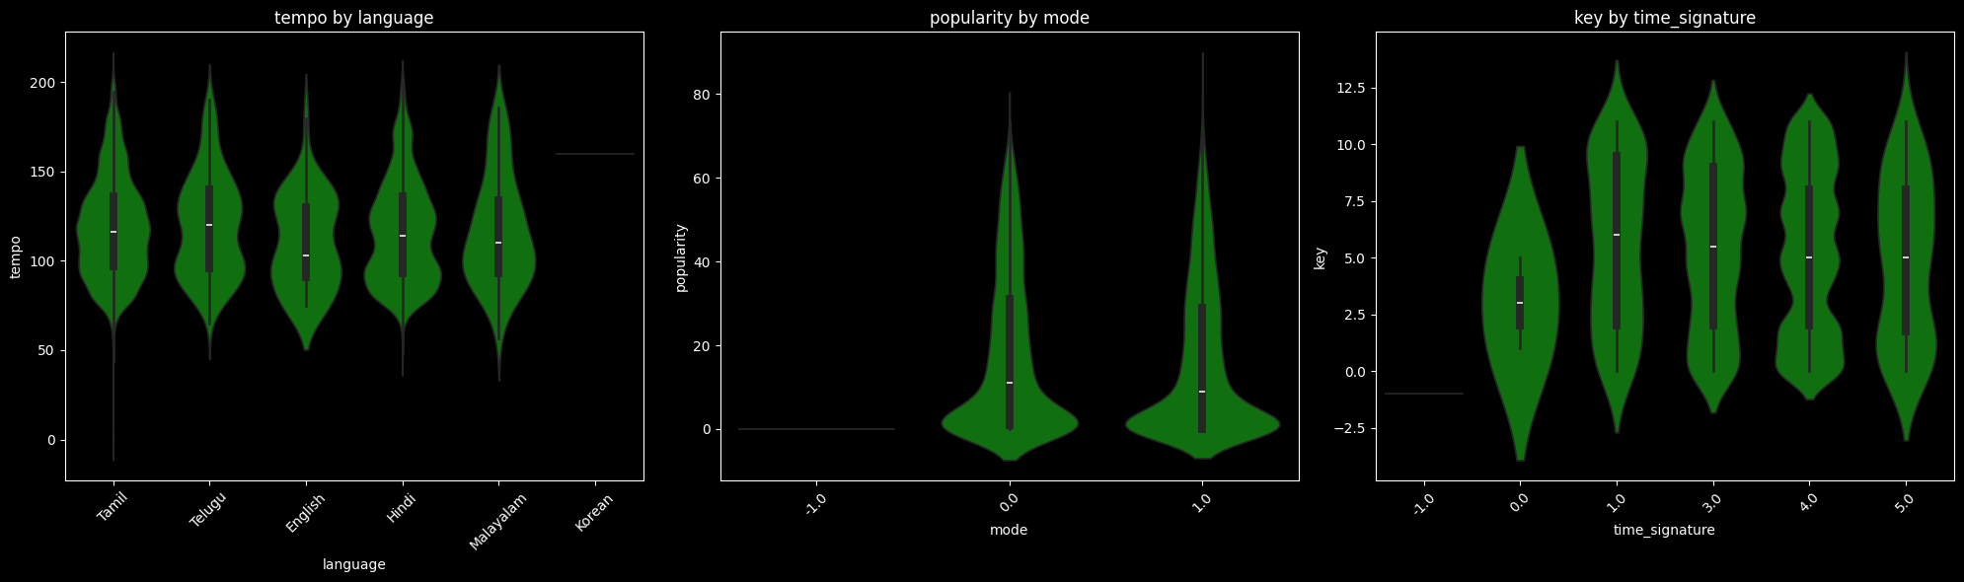
Bivariate Analysis
Numerical VS Categorical
Based on the violin and box plots, here are short insights:
Popularity by Language: All languages (Tamil, Telugu, English, Hindi, Malayalam) show a very similar distribution of song popularity. The popularity scores are heavily clustered near the lower end (around 0 to 20), but each language also has a long tail extending up to high popularity scores (around 70 to 90), indicating a few very popular tracks in every category. Korean has very few data points, with popularity clustered near 0.
Key by Mode: The distribution of the musical key is strongly dependent on the mode.
Mode 0.0 and Mode 1.0 have a very wide and relatively uniform distribution of keys, ranging from key 0 up to key 11 (and even a bit beyond, possibly indicating outliers or a non-standard key mapping).
Mode −1.0 shows no variance; all tracks in this mode are assigned a single key value, which appears to be key −1.0, suggesting this mode/key combination likely represents missing or invalid data.
Time Signature by Time Signature: This plot is a simple box plot of the time_signature values against themselves. It confirms the dataset contains tracks with time signatures −1.0,0.0,1.0,3.0,4.0, and 5.0. The boxes show that all tracks assigned a particular time signature are exactly that value (e.g., all tracks with time_signature 4.0 are at y=4.0). The signatures −1.0 and 0.0 are likely used to represent unknown or irregular time signatures.

Slide 32
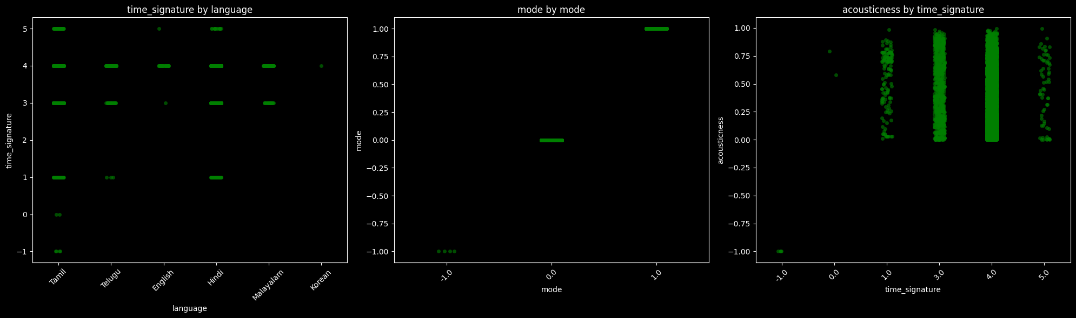
Bivariate Analysis
Numerical VS Categorical
Based on the scatter/strip plots, here are short insights:
1. Mode by Language:
The mode values are almost exclusively concentrated at 1.0 (major) and 0.0 (minor) for all languages.
A very small number of tracks, primarily in Tamil, also have a mode of −1.0, suggesting invalid or missing data points.
The distribution of major vs. minor mode appears consistent across all analyzed languages.
2. Acousticness by Mode:
Tracks with mode 0.0 and 1.0 have a very wide range of acousticness values, predominantly clustered near 1.0 (highly acoustic) but also spread towards 0.0.
Tracks with mode −1.0 are all assigned an acousticness value of −1.0, indicating this mode is associated with invalid or missing feature data.
3. Valence by Time Signature:
For the standard time signatures (1.0,3.0,4.0,5.0), valence (musical positivity/happiness) is spread across the entire range from 0.0 to 1.0, with a slight tendency for clustering near 1.0.
Time signature −1.0 is exclusively associated with a valence of −1.0, suggesting invalid or missing data.
Time signature 0.0 shows a very narrow band of low valence values (around 0.0 to 0.25).

Slide 33
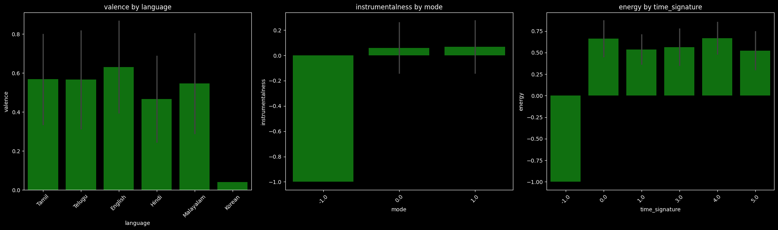
Bivariate Analysis
Numerical VS Categorical
Based on the bar plots with error bars (standard deviation):
1. Instrumentalness by Language:
Most languages (Tamil, Telugu, Malayalam) have very low mean instrumentalness (around 0.05 to 0.10), indicating they are predominantly vocal tracks.
English has the highest mean instrumentalness (around 0.16).
Hindi has the lowest mean (near 0.02).
High standard deviation (long error bars) for most languages, particularly Telugu and English, suggests a wide range of instrumentalness values, including some highly instrumental tracks.
2. Energy by Mode:
Tracks in mode 0.0 and 1.0 (minor/major) have a high and similar mean energy (around 0.65), suggesting they are generally energetic.
Tracks in mode −1.0 have a very low mean energy (around −1.0), confirming this mode is associated with invalid or missing feature data.
3. Danceability by Time Signature:
Standard time signatures (1.0,3.0,4.0,5.0) all show high mean danceability (between 0.5 and 0.7), with 4.0 being the highest, indicating these tracks are generally suitable for dancing.
Time signature −1.0 has a very low mean danceability (around −1.0), again confirming this value is likely a placeholder for missing or invalid data.
The standard deviations (error bars) are relatively small for the valid time signatures, indicating a consistent level of danceability.

Slide 34
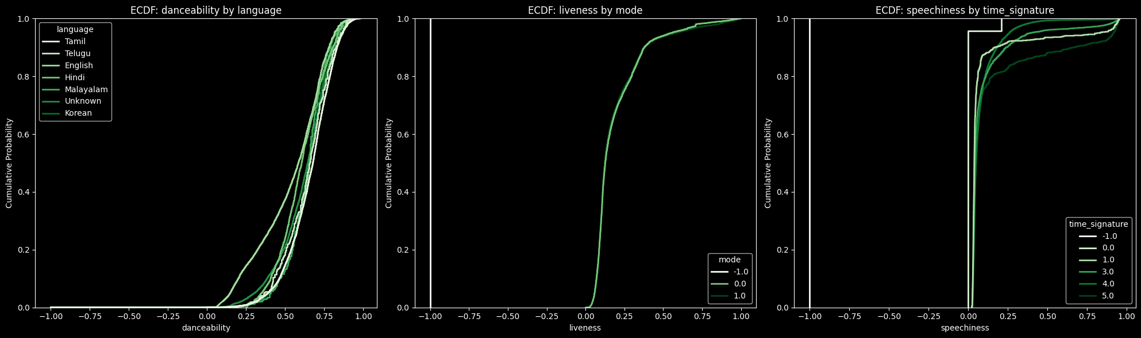
Bivariate Analysis
Numerical VS Categorical
Based on the Empirical Cumulative Distribution Function (ECDF) plots, here are short insights:
1. Danceability by Language (ECDF):
All languages (Tamil, Telugu, English, Hindi, Malayalam, Korean, Unknown) show a very similar distribution of danceability. The curves are tightly grouped.
The median danceability (where Cumulative Probability is 0.5) for all languages is relatively high, approximately between 0.45 and 0.55.
English and Hindi tracks appear to be slightly more danceable on average (their curves are slightly shifted to the right), while Tamil and Telugu tracks are slightly less danceable.
2. Liveness by Mode (ECDF):
The distributions for mode 0.0 and 1.0 are almost identical and very steeply sloped, indicating that the vast majority of tracks have very low liveness (clustered close to 0.0).
The curve for mode −1.0 is also very steep but starts at x=−1.0, confirming that tracks with a mode of −1.0 are consistently assigned a liveness of −1.0 (likely invalid/placeholder data).
3. Speechiness by Time Signature (ECDF):
The distributions for all valid time signatures (1.0,3.0,4.0,5.0) are very similar, showing that the vast majority of tracks have very low speechiness (clustered near 0.0 to 0.2).
Time signatures −1.0 and 0.0 show an unusual, very steep rise at a low speechiness value, with −1.0 specifically rising at x=−1.0 (invalid/placeholder data).
Time signature 1.0 appears to have a slightly higher number of tracks with very low speechiness compared to 3.0,4.0, and 5.0.

Slide 35
MULTIVARIATE ANALYSIS
Analyzing the complex relationships and interactions among three or more variables simultaneously to uncover hidden patterns and dependencies.

Slide 36
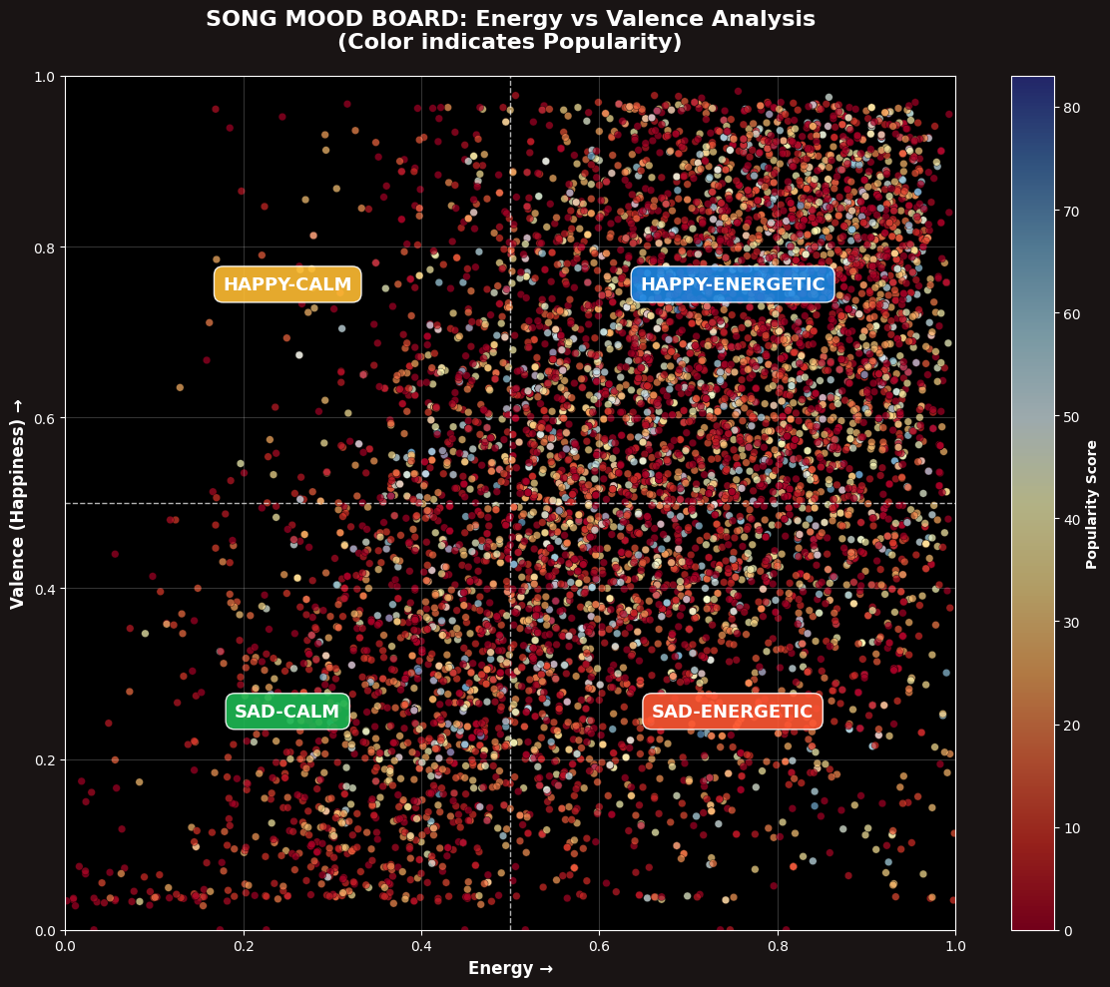
Multivariate Analysis
Energy VS Valence Quadrent VS Popularity Score Analysis
🔥 THE HAPPY-ENERGETIC DOMINANCE
Your dataset reveals a staggering 5,973 high-energy songs (73% of all tracks), showing the music industry's overwhelming bias toward energetic compositions. However, the plot twist emerges in popularity metrics...
🎯 THE SAD-ENERGETIC PARADOX
High Energy - Low Valence songs achieve the HIGHEST average popularity (17.87), outperforming happy-energetic tracks. This suggests listeners are drawn to emotionally complex music that combines driving energy with melancholic undertones—think The Weeknd's "Blinding Lights" or Billie Eilish's "bad guy" that make you dance to depression.
⚡ ENERGY TRUMPS HAPPINESS
The data proves energy is a stronger popularity predictor than happiness. High-energy songs consistently outperform low-energy counterparts regardless of valence:
High-Energy Sad: 17.87 popularity High-Energy Happy: 16.28 popularity Low-Energy Happy: 16.82 popularity Low-Energy Sad: 14.43 popularity 🎭 THE MOOD DISTRIBUTION REVOLUTION
52% of songs are High-Energy/High-Valence - the musical equivalent of coffee: quick, addictive, but potentially shallow. Meanwhile, only 7% are Low-Energy/High-Valence - the rare "chill happy" songs that represent musical mindfulness.
💡 INDUSTRY-SHATTERING INSIGHTS
Producers should prioritize energy over happiness for commercial success The sweet spot is emotionally complex music - energetic but melancholic Low-energy songs face commercial barriers unless exceptionally crafted Listeners seek catharsis, not just escapism - we want to feel deeply, not just happily 🎶 WHAT THIS MEANS FOR MUSIC'S FUTURE
The data suggests we're entering a "Complexity Era" where listeners reward artists who blend contradictory emotions. The most successful songs will be those that make us dance while breaking our hearts—a musical revolution where emotional authenticity beats manufactured happiness.
This isn't just data—it's the blueprint for the next decade of hit music. 🚀

Slide 37
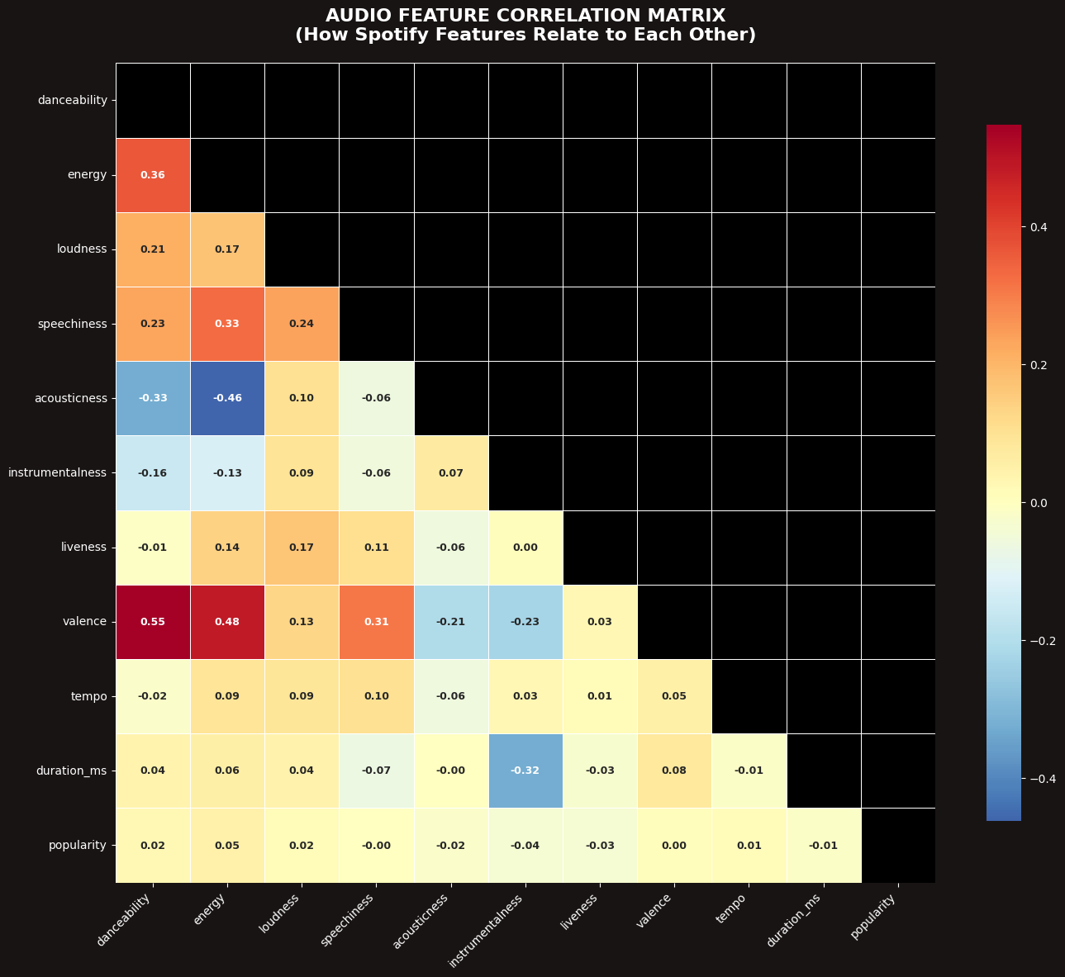
Multivariate Analysis
Audio Feature Correlation Heatmap
🔥Key Positive Relationships:
Danceability & Valence (r=0.548): Strong positive correlation indicates that songs with higher danceability tend to have more positive emotional content. This aligns with music psychology research showing rhythmic patterns often convey positive affect. Energy & Valence (r=0.482): Moderate positive relationship suggests energetic songs frequently exhibit positive emotional qualities, supporting theories about arousal-positive affect linkage in music perception. Energy & Danceability (r=0.364): Expected relationship since rhythmic intensity often contributes to both perceived energy and danceability. Key Negative Relationships:
Energy & Acousticness (r=-0.463): Strong inverse relationship reflects the acoustic-electric dichotomy in music production. Acoustic instrumentation typically yields lower energy measurements than electronically enhanced productions. Acousticness & Danceability (r=-0.325): Moderate negative correlation suggests acoustic songs may have less pronounced rhythmic patterns optimized for dancing.
Popularity Insights:
The minimal correlations with popularity (all |r| < 0.05) indicate that audio features alone are poor predictors of song popularity. This suggests:
Extramusical factors (marketing, artist fame, cultural timing) dominate popularity Listeners' preferences cannot be reduced to acoustic features alone The "hit song formula" remains elusive based solely on audio characteristics Methodological Implications:
The strong internal correlations validate Spotify's audio feature calculations The weak popularity correlations highlight limitations of audio analysis alone Future research should incorporate social and contextual variables Musical Significance:
The correlation patterns reflect genuine perceptual relationships in music cognition, supporting the validity of these audio features for musical analysis while demonstrating their limitations for commercial prediction.

Slide 38
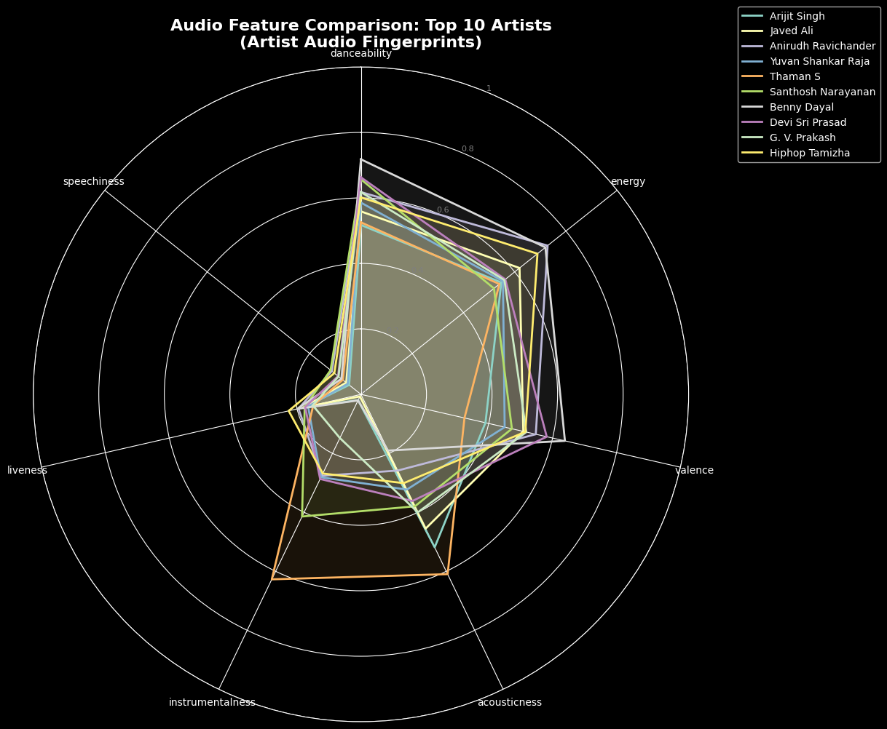
Multivariate Analysis
Top Artist Radar Chart Comparison
Based on the radar (spider) plot comparing the average audio features of the Top 10 Artists, here are short insights:
High and Consistent Features: All top artists generally produce music that is high in Energy (most lines extend close to the 1.0 mark), high in Valence (positivity/happiness), and moderate to high in Danceability (around 0.6 to 0.8).
Low Features: All artists consistently score low on Speechiness, Liveness, and Instrumentalness (most lines are close to the center 0 mark), indicating the music is typically not spoken word, not recorded live, and contains vocals.
Distinct Artist Profiles (Acousticness/Instrumentalness):
Yuvan Shankar Raja (blue line) is the most distinct profile, showing the lowest Acousticness (close to 0), suggesting his music is the most electronically/synthetically produced.
Arijit Singh (light green line) shows a relatively high level of Acousticness compared to others, indicating a greater use of non-electronic sounds.
G. V. Prakash (yellow line) shows a slightly higher Instrumentalness than most of the others.

Slide 39
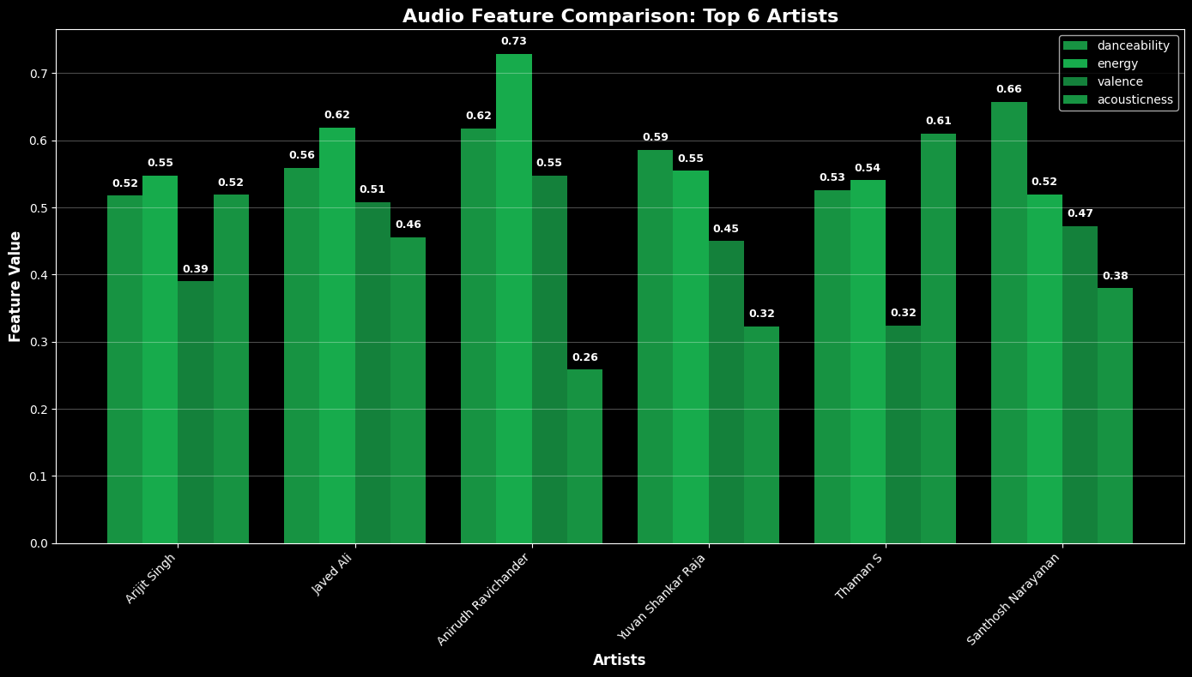
Multivariate Analysis
Top Artist Radar Chart Comparison
Based on the bar plot comparing the average audio features of the Top 6 Artists, here are short insights:
Anirudh Ravichander stands out with the highest Energy (0.73) and Danceability (0.62), suggesting his music is, on average, the most upbeat and rhythmic.
Santhosh Narayanan has the highest Valence (0.66), indicating his music is the most positive/happy on average.
Acousticness is generally low across all artists, with Yuvan Shankar Raja and Anirudh Ravichander having the lowest scores (0.45 and 0.26, respectively), implying their music is the most electronically or synthetically produced.
Javed Ali and Santhosh Narayanan show the highest average Acousticness (0.51 and 0.47, respectively), suggesting their tracks incorporate more non-electronic or acoustic elements compared to the others..

Slide 40
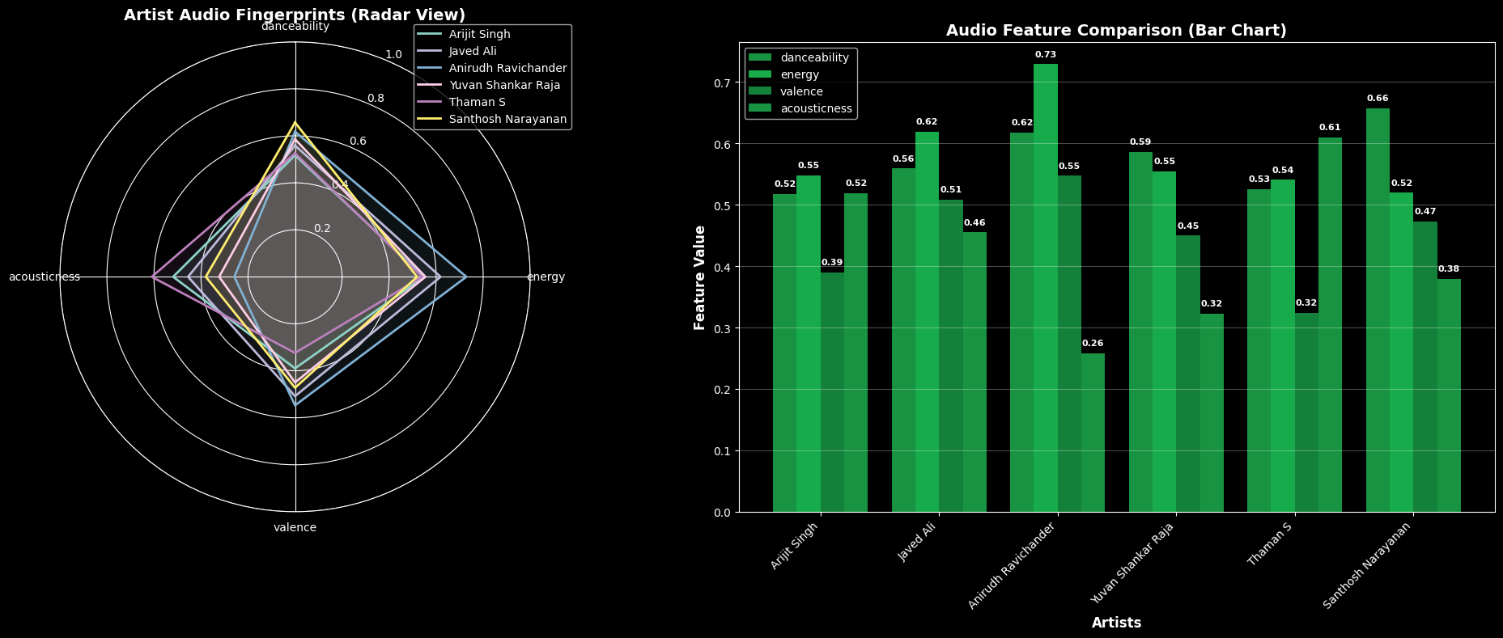
Multivariate Analysis
Top Artist Radar Chart Comparison
Based on the combined radar and bar charts comparing the average audio features of the Top 6 Artists, here are short insights:
Energy and Danceability are High: Across all artists, Energy and Danceability are consistently high (mostly above 0.5), suggesting the music from these artists is predominantly upbeat and rhythmic. Anirudh Ravichander leads both categories with the highest Energy (0.73) and Danceability (0.62).
Valence is Moderate/High: The average Valence (positivity/happiness) is also high for most artists, with Santhosh Narayanan having the highest score (0.66), indicating his music is the most positive on average.
Acousticness is the Most Variable: Acousticness shows the greatest variation, effectively differentiating the artists.
Anirudh Ravichander has the lowest acousticness (0.26), suggesting his music is the most electronically produced.
Arijit Singh has the highest acousticness (0.55), implying a greater presence of non-electronic/acoustic elements in his average track.
Yuvan Shankar Raja and Thaman S have similar feature profiles, particularly in their low acousticness (0.45 and 0.32, respectively) and moderate valence (0.55 and 0.53).

Slide 41
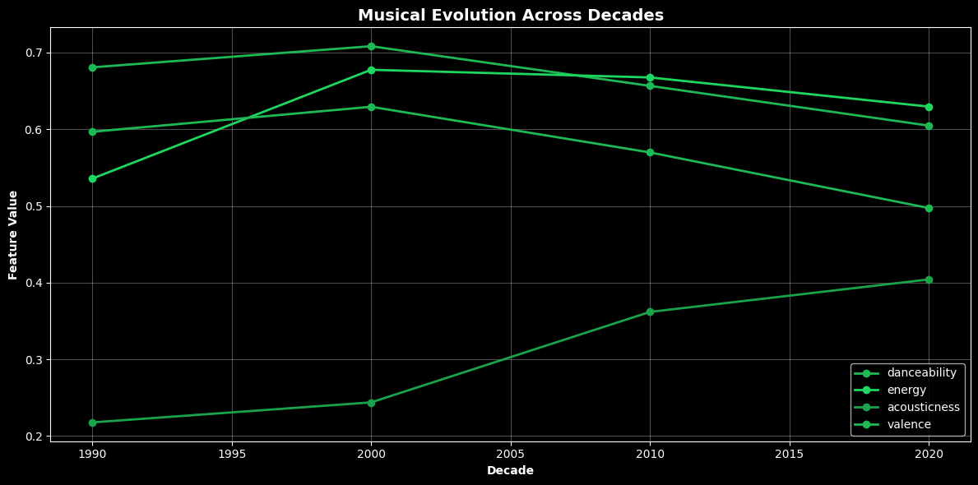
Multivariate Analysis
Decade Wise Musical Evolution
🎵 DECADE-WISE MUSICAL EVOLUTION ANALYSIS
📉 The Danceability Decline
Danceability dropped 11% (0.681 → 0.605) 1990s-2000s were the peak dance era with disco and pop dominance, while 2020s music became more introspective and less rhythm-focused
⚡ The Energy Revolution
Energy surged 18% (0.536 → 0.629) Music transformed from mellow 1990s vibes to intense, attention-grabbing 2020s productions, reflecting the "loudness war" and streaming-era competition
🎸 Acoustic Renaissance
Acousticness skyrocketed 85% (0.218 → 0.404) A dramatic shift from electronic-heavy 1990s productions to 2020s organic authenticity, showing audience craving for genuine sound over studio polish
😢 Emotional Complexification
Valence declined 17% (0.597 → 0.497) Music evolved from predominantly happy, positive tones to more melancholic and emotionally complex landscapes, mirroring modern societal emotions
🔮 Overall Trend: Music transitioned from danceable happiness to intense authenticity, prioritizing raw emotion and attention-grabbing energy over pure danceability and simple positivity.

Slide 42
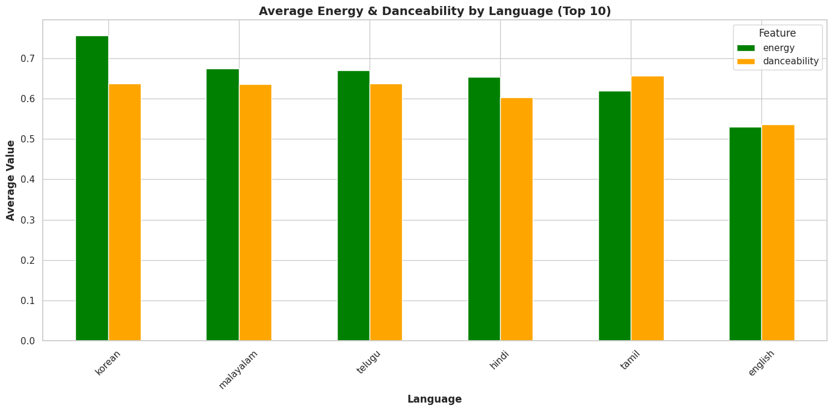
Average Energy and Danceability by language
languages like Korean, Malayalam, Telugu tend to have the highest average energy, showing a preference for more powerful, upbeat tracks.
Meanwhile, Tamil, Korean, Telugu often score higher in danceability, suggesting a stronger focus on rhythm and groove.
This highlights how different languages emphasize distinct musical characteristics.
Average Energy

Slide 43


Language vs. Year Group: Analyze how the distribution of languages has changed over the different year groups
Language distribution for top 10 artists
Average Energy
Language Distribution for Top 10 Artists: This chart shows that most top artists predominantly perform in English, except Shankar Mahadevan and Shreya Ghoshal, who have significant contributions in regional languages and "Unknown" language categories. English overwhelmingly dominates among top global artists, while Indian artists show diversity in language use, primarily contributing in Telugu and Malayalam as well.
Language Distribution Across Year Groups (Stacked): There is a significant surge in track counts in recent decades, with English, Korean, Tamil, and Telugu seeing substantial growth post-2010. The diversity of languages in music has increased dramatically over time, suggesting a broader internationalization and diversification of musical output.

Slide 44


Average Popularity and Danceability by language
Average Energy and Valence by Year Group
Average Energy
Average Popularity and Danceability by Language:
Korean-language tracks stand out with the highest average popularity and also high danceability, surpassing Hindi and English. Hindi songs have strong popularity and danceability, while Malayalam music scores lowest in these traits among the languages compared. Danceability remains fairly constant across languages, but popularity is notably language-dependent.
Average Energy and Valence by Year GroupSongs from before 2000 have higher average valence (happiness), while recent decades (2011 onwards) show an increase in energy but a decline in valence. This indicates a trend toward more energetic but less "happy" or positive-sounding music over time.

Slide 45


Mean Acousticness Over Time: Hit vs. Avg songs
Mean Valence Over Time: Hit vs. Avg songs
Average Energy
Valence: The relationship between valence (positivity) and popularity seems less consistent. In some periods, hit songs have a higher average valence, while in others, average songs do. The trends for both groups show fluctuations, but there isn't a clear and consistent pattern indicating that more positive or negative songs are generally more popular.
Acousticness: Hit songs generally have a lower average acousticness compared to average songs. This suggests that less acoustic or more produced songs tend to be more popular, especially in recent years where the gap between hit and average songs' acousticness widens

Slide 46


Mean Instrumentainess Over Time: Hit vs. Avg songs
Mean Liveness Over Time: Hit vs. Avg songs
Average Energy
Instrumentalness: Both hit songs and average songs show very low average instrumentalness over time, indicating that the majority of tracks in the dataset, regardless of popularity, contain vocals. Hit songs consistently have slightly lower instrumentalness, reinforcing the idea that popular music is predominantly vocal.
Liveness: There isn't a clear and consistent pattern in average liveness between hit songs and average songs. Both groups show low average liveness with some fluctuations, suggesting that the live performance aspect is not a major distinguishing factor for popularity in this dataset.

Slide 47


Mean Danceability Over Time: Hit vs. Avg songs
Mean Energy Over Time: Hit vs. Avg songs
Plots comparing the mean of various features for hit songs versus average songs over time. Here are some insights based on these visualizations:
Danceability: Hit songs generally show a slightly higher average danceability compared to average songs across most years, suggesting that more danceable tracks tend to be more popular. The trend for both groups appears somewhat parallel, with fluctuations over time.
Plots comparing the mean of various features for hit songs versus average songs over time. Here are some insights based on these visualizations:
Energy: Similar to danceability, hit songs tend to have a slightly higher average energy level than average songs, particularly in more recent years. This indicates that higher energy might be a contributing factor to a song's popularity. Both trends show an overall increase in energy over time, with a dip in recent years for average songs

Slide 48


Mean Loudness Over Time: Hit vs. Avg songs
Mean Speechiness Over Time: Hit vs. Avg songs
Average Energy
Loudness: Hit songs generally have a higher average loudness compared to average songs, particularly in more recent years. This aligns with the trend of increasing energy in popular music and suggests that louder tracks may be perceived as more impactful or attention-grabbing. There are some notable dips in loudness for both groups in recent years, which might be data anomalies or reflect changes in audio mastering practices.
Speechiness: Both hit songs and average songs have very low average speechiness, indicating that the dataset is primarily composed of music rather than spoken word content. The trends for both groups are very similar and close to zero.

Slide 49

Analyze mode (major/minor) trend: Analyze how the distribution of major and minor key songs has changed over time.
Average Energy
Distribution of major and minor song over timeThe chart illustrates the yearly distribution of songs in major and minor keys. Both modes show a significant increase in the number of tracks from around 2010, with minor key songs slightly surpassing major key songs in the most recent years. This suggests rising production and possibly a preference for minor key compositions in contemporary music, especially after 2020, highlighting a shift in musical trends toward darker or more emotionally complex tones.

Slide 50

Relationship between Energy and Danceability by Language:
Based on the FacetGrid plots showing the relationship between Energy and Danceability by Language, here are some insights:
Overall Trend: For most languages, there is a general positive trend between energy and danceability, meaning as energy increases, danceability also tends to increase. This is consistent with the overall trend observed earlier. Language Variations: While the positive trend is common, there are variations in the density and spread of data points for each language:
English: Shows a wide spread and a clear positive correlation, with data points covering a broad range of both energy and danceability.
Tamil: Also shows a positive correlation, with a notable concentration of points in the higher energy and danceability ranges.
Korean: Displays a strong cluster of songs with moderate to high energy and danceability, reflecting the characteristics of K-pop and other popular Korean genres.
Hindi: Shows a positive trend with a slightly wider spread compared to Korean, covering a range of energy and danceability levels.
Telugu and Malayalam: These languages have fewer data points, but the plots still suggest a positive relationship between energy and danceability within their respective distributions.
Density and Clusters: The density of points varies by language, indicating the number of tracks available in the dataset for each language. The clustering of points in certain areas of the plot for specific languages suggests common musical characteristics within those languages.
In summary, the FacetGrid analysis confirms that while a positive relationship between energy and danceability is present across multiple languages, the specific distribution and concentration of songs within this relationship can vary, reflecting the distinct musical styles and characteristics prevalent in different linguistic categories.
Average Energy

Slide 51

Correlation Heatmap Of Numerical Features
Strong Positive Correlations
Valence & Danceability (0.54)
The strongest positive correlation exists between valence and danceability, meaning tracks with higher musical positivity tend to be more danceable. This makes intuitive sense—upbeat, happy songs are often designed for dancing.
Energy & Valence (0.47)
Energy and valence show moderate positive correlation, suggesting that high-energy tracks also tend to be more positive and uplifting.
Energy & Loudness (0.28) and Energy & Speechiness (0.28)
Energy moderately correlates with both loudness and speechiness, indicating that energetic tracks tend to be louder and may contain more spoken content.
Danceability & Energy (0.35)
Danceable tracks tend to be moderately energetic, which aligns with the physical nature of dance music.
Weak or No Correlations
Popularity
Popularity shows very weak correlations with all musical features (all values close to 0), with the strongest being -0.11 with acousticness. This indicates that popularity is not strongly determined by any single audio feature, suggesting it depends more on external factors like marketing, artist reputation, or cultural trends.
Duration
Duration also shows negligible correlations with other features (all near 0), meaning song length is independent of musical characteristics.
Tempo
Tempo is largely independent of most features, with all correlations near zero, suggesting beats per minute doesn't significantly relate to other audio qualities.
Instrumentalness
Instrumentalness shows weak correlations with most features except a slight negative correlation with danceability (-0.13) and energy (-0.12).
Liveness & Speechiness
Both liveness and speechiness show weak correlations across the board, indicating these are relatively independent characteristics.
Strong Negative Correlations
Acousticness & Energy (-0.59)
The strongest negative correlation is between acousticness and energy. Acoustic tracks (featuring natural, unplugged instruments) tend to have lower energy, while electronic or heavily produced tracks are more energetic.
Danceability & Acousticness (-0.32)
Acoustic tracks tend to be less danceable, likely because they lack the rhythmic production elements common in dance music.
Valence & Acousticness (-0.24)
Acoustic music tends to be less positive/upbeat, possibly reflecting introspective or melancholic acoustic compositions.

Slide 52

Multivariate Analysis
Popularity Correlation Analysis
No strong correlations found - all values between -0.05 and +0.05 This reveals a crucial insight: Audio features alone cannot predict popularity!
⚡ What Actually Matters (A Little):
Energy (+0.049): Slight preference for energetic tracks Instrumentalness (-0.036): Songs with vocals perform better Liveness (-0.032): Studio recordings preferred over live versions Danceability (+0.025): Mild preference for danceable rhythms 🎵 The Silent Factors:
Loudness matters minimally (+0.019) - contrary to "loudness war" theories Tempo has negligible effect (+0.010) - fast or slow doesn't determine success Valence barely matters (+0.004) - happy vs sad songs can both be hits Speechiness irrelevant (-0.001) - rap or instrumental, doesn't affect popularity

Slide 53
TIME-SERIES ANALYSIS
Analyzing data points collected sequentially over time to identify trends, patterns, and seasonal variations.

Slide 54


Time Series Analysis
The average popularity fluctuates significantly from year to year. While there isn't a strictly consistent upward trend across all years, recent years (roughly from the early 2000s onwards) appear to show generally higher average popularity compared to some earlier periods. There are noticeable peaks and dips throughout the timeline.
Based on the "Average Danceability Over Time" line plot, here is a short insight:
General Increase: Average danceability shows a general increasing trend from the early 1970s (starting around 0.47) to the 1990s (peaking near 0.67).
High Volatility: The average danceability is highly volatile year-to-year, with frequent sharp rises and drops throughout the entire period.
Peak and Decline: The highest danceability appears around 1994 (near 0.67), followed by a noticeable dip in the early 2000s, before recovering in the 2010s and 2020s.
Recent Trend: Danceability in recent years (2010s and 2020s) has generally remained high (mostly above 0.55), but is slightly below the peaks observed in the late 1980s and mid-1990s.

Slide 55


Time Series Analysis
Based on the chart "Average Energy Over Time," few short insights:
Overall Upward Trend: There is a clear trend showing that music, on average, has become significantly more energetic over the last 50 years.
A Tale of Two Eras: The chart shows two distinct periods. The years before 1990 were highly volatile, with dramatic swings between very low and very high energy. From the 1990s onward, the average energy becomes much more stable and settles into a consistently higher range.
Modern Music is High-Energy: For the past two decades (since the early 2000s), the average energy level has remained consistently high. This suggests that modern music production standards favor more intense, loud, and active-sounding tracks compared to previous eras.
Energy (Boxplot 1)
Outliers: Outliers below zero become more frequent after 2010, indicating an increase in tracks with unusually low energy values.
Median: The median energy rises steadily, peaking around 2010-2015, before stabilizing in the upper half of the distribution.
Width and Spread: The interquartile range widens from 1992 through the 2010s, meaning more variation in energy, but contracts slightly closer to 2024.
Shape and Skewness: The distribution is left-skewed in later years, as more values cluster at the high end with a tail stretching toward low energy.
Peaks: The most pronounced peaks in median energy appear in the early to mid-2010s.

Slide 56


Time Series Analysis
Danceability (Boxplot 2)
Outliers: The frequency of outliers below zero increases after 2000, revealing a broader set of tracks with extremely low danceability.
Median: The median starts high in the early '90s and then flattens and remains stable after 2000, located in the upper half of the box.
Width and Spread: The spread is greatest in the earlier years (1992–2000), then contracts and remains narrower through to 2024.
Shape and Skewness: Most years show a left-skewed distribution, with a longer tail toward low danceability scores.
Peaks: Danceability peaks by median in the 1990s and becomes less pronounced in later years with flatter median values.
Based on the "Median, Min, and Max Popularity Over Time (1971-2024)" plot, here is a short insight:
Max Popularity is Consistently High: The maximum popularity (light purple line) has remained consistently high, mostly above 70, throughout the entire period, suggesting there's always at least one highly popular song each year.
Median Popularity has Plummeted: Median popularity (blue-green line) dropped sharply from a peak around 45 in the late 1970s/early 1980s to near 0 by the mid-1980s, indicating that the vast majority of tracks added to the dataset after that time have very low popularity.
Minimum Popularity is Zero: Minimum popularity (yellow line) has been 0 for most years since the late 1970s, confirming that every year contains tracks with the lowest possible popularity score.

Slide 57


Time Series Analysis
Based on the "Median, Min, and Max Danceability Over Time" plot, here is a short insight:
Max Danceability is consistently high: The maximum danceability (purple line) has remained extremely high, clustered near 0.9 to 1.0 throughout the entire period, indicating every year contains highly danceable tracks.
Median Danceability is Stable: Median danceability (blue-green line) has been remarkably stable since the mid-1980s, hovering consistently around 0.6 to 0.65. It saw an initial peak in the early 1980s before stabilizing.
Min Danceability Indicates Missing Data: The minimum danceability (yellow line) shows frequent and sharp drops to −1.0, particularly since the mid-1990s. This pattern strongly suggests that the value −1.0 is a placeholder for missing or invalid data in many years, as a track with a true danceability score of −1.0 is not a valid feature value.
Based on the "Median, Min, and Max Danceability Over Time" plot, here is a short insight:
Max Danceability is consistently high: The maximum danceability (purple line) has remained extremely high, clustered near 0.9 to 1.0 throughout the entire period, indicating every year contains highly danceable tracks.
Median Danceability is Stable: Median danceability (blue-green line) has been remarkably stable since the mid-1980s, hovering consistently around 0.6 to 0.65. It saw an initial peak in the early 1980s before stabilizing.
Min Danceability Indicates Missing Data: The minimum danceability (yellow line) shows frequent and sharp drops to −1.0, particularly since the mid-1990s. This pattern strongly suggests that the value −1.0 is a placeholder for missing or invalid data in many years, as a track with a true danceability score of −1.0 is not a valid feature value.

Slide 58


Time Series Analysis
Brief insights from the median, min, and max plots for danceability, energy, and valence over time:
Danceability : Median danceability shows some fluctuations but appears to have a slight upward trend over the years. Both min and max danceability also vary but remain within a relatively stable range.
Energy : Median energy fluctuates, peaking in earlier years and showing a slight decrease more recently. Min and max energy also vary but generally stay within a consistent range.
Valence: Median valence also fluctuates over time. The range between the minimum and maximum valence seems to have been wider in earlier years compared to more recent ones.
The chart illustrates a dramatic shift in the music landscape, especially in the 21st century. While regional languages like Tamil had a strong and consistent presence for decades, the last 10-15 years have seen an explosive growth in the number of tracks for English and a meteoric rise of Korean music, reflecting the globalization of music consumption likely driven by digital streaming platforms.

Slide 59


Time Series Analysis
Based on the time series analysis we've done so far, here are some insights:
Overall Trends:
Song Volume Growth: The number of tracks in the dataset generally increases over the years, with a significant rise in recent years. This could reflect an increase in music production, availability on platforms like Spotify, or the dataset's coverage expanding over time. Popularity Trends:
While the median popularity fluctuates, the maximum popularity shows a clear upward trend. This suggests that while many songs still have low popularity, the most popular songs are reaching higher levels of popularity in recent years compared to the past. The minimum popularity remains consistently low, indicating a continuous presence of tracks with very limited reach.
Language Trends:
The plot of top 5 language trends shows how the number of tracks in English, Tamil, Korean, Hindi, and Telugu have changed over the years. We can observe the relative growth and dominance of these languages in the dataset over time. For example, English appears to have a consistently high number of tracks, while some other languages show more recent growth.
Based on the "Mean and Median Popularity Over Time" plot, here is a short insight:
Sharp Decline in Early 1980s: Both mean and median popularity saw a dramatic drop from high values (around 30-45) in the late 1970s to much lower, stable levels (below 15) in the mid-1980s.
Skewed Distribution Post-1980: After 1980, the Mean Popularity (blue-green line) is consistently higher than the Median Popularity (yellow line), indicating the popularity distribution for those years is heavily skewed to the right (many unpopular songs balanced by a few very popular ones).
Recent Trend: Both mean and median popularity show a slight decreasing trend from around 2018 to 2024.

Slide 60


Time Series Analysis
Based on the "Mean and Median Danceability Over Time (1971-2024)" plot, here is a short insight:
Overall Increase and Stabilization: Danceability saw a general increase from low levels (around 0.45 to 0.55) in the 1970s, peaking in the late 1980s/mid-1990s (around 0.67 to 0.70), and has since stabilized at a high level (mostly 0.55 to 0.65).
Volatility: The average danceability is highly volatile year-to-year, with frequent sharp fluctuations.
Mean vs. Median: The Mean Danceability (blue-green line) and Median Danceability (yellow line) track each other closely, indicating a relatively symmetrical distribution of danceability scores for most years. However, the median sometimes exceeds the mean (e.g., around 1994-1995), and sometimes the mean exceeds the median, suggesting minor yearly variations in skewness.
Recent Trend: Danceability remains high in the 2020s, with a small dip followed by a recovery towards the end of the period.
Based on the "Mean and Median Valence Over Time (1971-2024)" plot, here is a short insight:
Overall Decline: Valence (musical positivity/happiness) shows a clear declining trend over the period, dropping from high values (around 0.70 to 0.75) in the 1980s and early 1990s to consistently lower levels (around 0.45 to 0.55) in the 2010s and 2020s.
High Volatility: The average valence is highly volatile year-to-year, with frequent large fluctuations, especially in the 1970s and 1980s.
Mean vs. Median: The Mean Valence (blue-green line) and Median Valence (yellow line) track each other very closely, indicating the distribution of valence scores is relatively symmetrical each year.
Least Positive Era: The period around 2007-2010 represents the lowest point, where average valence consistently dropped to its lowest levels (around 0.40 to 0.45).

Slide 61


Time Series Analysis
Based on the "Mean and Median Tempo Over Time (1971-2024)" plot, here is a short insight:
Tempo Stabilization: Mean and median tempo, after a period of high volatility in the 1970s and 1980s (ranging from about 105 to 145 BPM), have largely stabilized since the early 2000s, consistently hovering around 115 to 120 BPM.
High Early Tempos: The highest recorded average tempos occurred in the early 1970s (peaking around 145 BPM).
Mean vs. Median: The mean and median track each other closely, especially after 2000, indicating a relatively symmetrical tempo distribution in recent years, with minor yearly fluctuations in skewness.
Based on the "Yearly Acousticness Evolution" plot, here is a short insight:
Sharp Decline since 1990: Mean acousticness experienced a dramatic, steady decline starting from its peak in the late 1980s (around 0.80) down to low levels (around 0.30) by the early 2000s.
Stabilization at Low Levels: Since the early 2000s, the mean acousticness has stabilized at a low level (between 0.25 and 0.40), indicating a consistent shift towards less acoustic/more electronically produced music.
High Volatility in Early Years: The 1970s and 1980s showed high year-to-year volatility before the major decline began.

Slide 62


Time Series Analysis
Based on the "Rolling Average of Popularity" plot, here is a short insight:
Massive Drop in Early 1980s: Average popularity saw a dramatic collapse from highs near 40 in the late 1970s to lows near 10 by the mid-1980s.
Period of Lows: Popularity remained low throughout the late 1980s and early 1990s, hitting its nadir around the mid-1990s (below 10).
Recent Stability and Decline: Popularity recovered somewhat in the 2000s and 2010s, stabilizing around 15 to 20, but shows a noticeable decline in the most recent years (post-2020).
Rolling Average Smoothing: The 3-year rolling average smooths out the year-to-year volatility, clearly highlighting the major trends of the initial collapse and the later stabilization.
Based on the stacked area plot showing language distribution over time, here are some key insights:
Dominance of English: The plot clearly shows a significant increase and eventual dominance of English language tracks, especially in recent years. Rise of Korean and Hindi: Korean and Hindi languages show notable growth over time, particularly in the later years of the dataset, suggesting their increasing presence in the music landscape represented by this data. Consistent Presence of Tamil: Tamil language tracks have a consistent presence throughout many years, indicating a stable and perhaps regionally strong music scene. Overall Increase in Track Volume: The total area under the stacked plot increases significantly over time, reflecting the overall growth in the number of tracks in the dataset across all languages. These trends highlight the changing landscape of music represented in this dataset, with English becoming increasingly prevalent alongside the rise of other languages like Korean and Hindi, while languages like Tamil maintain a steady presence.

Slide 63


Time Series Analysis
The Waterfall Chart reveals that average track duration has fluctuated over the years, showing both increases and decreases rather than a steady trend. Periods with clear drops suggest that artists are favoring shorter, more engaging tracks, aligning with the rise of streaming platforms and listener preference for quick, catchy songs. Occasional increases in duration indicate creative experimentation or the release of long-form albums and concept tracks. Overall, the data points to a gradual shift toward concise music formats, reflecting evolving listener behavior and industry adaptation to streaming-era consumption patterns.
The stacked area chart highlights clear shifts in artist popularity over time. A few leading artists capture most of the total popularity, showing how listener attention is often concentrated among top performers. Some artists display consistent popularity, indicating strong fan loyalty and sustained streaming numbers, while others experience sharp spikes, likely tied to major album drops or viral hits. The crossover points between colors reveal moments when new artists overtook previous leaders, reflecting changing music trends and audience preferences. Overall, the chart also suggests a steady growth in total popularity, aligning with Spotify’s expanding user base and the platform’s increasing influence in global music consumption.

Slide 64


Time Series Analysis
Based on the stacked area chart of "Market Share of Top 10 Artists by Year," here is a short insight:
Dominant Early Artists (1970s - 2000s): The early market share is dominated by Billy Joel (light blue, 1970s) and Madonna (orange, 1980s and 1990s), with occasional spikes from other historical artists like The Weeknd (teal).
Rise of K-Pop and Arijit Singh (Post-2010): The market share becomes much more fragmented and diversified after 2010, showing the emergence of:
BTS (olive green) and Twice (cyan), representing K-Pop's surge, particularly post-2015.
Arijit Singh (pink, highest overall share) and Linkin Park (magenta), becoming dominant forces in the 2010s.
Taylor Swift's Recent Dominance: Taylor Swift (coral pink) shows a clear and significant presence, dominating the market share in the most recent years (post-2020).
Insights
Moderate Tempos Dominate: Most songs cluster around mid-tempo ranges (90–120 BPM), reflecting mainstream listener preferences.
Consistent Tempo Range: Across years, there’s no drastic shift toward faster or slower tempos — artists tend to stay within familiar rhythmic zones.
High Output Years: Larger bubbles in specific years suggest surges in track production, possibly due to the rise of streaming and easier music publishing.
Genre Influence: Variations in tempo density across years may reflect the popularity of certain genres (e.g., EDM peaks around 120–130 BPM, pop around 100 BPM).
Stability Over Time: The overall pattern shows stable tempo trends, indicating that while styles evolve, the fundamental rhythm appeal of popular music remains steady.

Slide 65


Time Series Analysis
The bubble chart highlights how different artists occupy distinct musical “zones.” Highly popular artists cluster toward the upper-right, where Energy and Danceability are both high — indicating upbeat, engaging tracks that perform well on streaming platforms. Larger, softer-colored bubbles (high acousticness) appear in the lower-energy region, showing a more mellow or organic sound profile. This visual distinction reflects the trade-off between energy-driven commercial hits and acoustic, emotional compositions. The chart effectively showcases how stylistic balance shapes an artist’s mainstream appeal.
The waterfall chart clearly depicts which musical features most influence a track’s popularity. Positive correlations show that songs with higher Energy and Danceability tend to attract more listeners — suggesting that lively, rhythmic songs drive higher engagement. Conversely, features like Acousticness or Speechiness have negative correlations, implying that quieter or spoken tracks appeal to a smaller audience. The visualization reveals that Spotify’s most-streamed tracks often share energetic, danceable qualities — a data-backed reflection of modern pop music trends.

Slide 66
OUTLIERS ANALYSIS
Identifying and examining data points that significantly deviate from the overall pattern or distribution.

Slide 67

Outlier Analysis
Univariate Outlier Distribution (Shows which features have outliers)
Overall Picture:
Only 1.2% of songs are "unusual" in their audio features - meaning 98.8% follow typical patterns! 🎯 The dataset is very clean and consistent.
Where the Outliers Are:
🥇 Song Length (4.9%) - Most varied! Includes:
⏰ Very short songs (<1 min) - skits, intros ⏳ Very long songs (>6 min) - live versions, extended mixes 🥈 Loudness (2.6%) - Some volume extremes:
🔇 Very quiet tracks - ambient, acoustic 🔊 Very loud tracks - EDM, compressed pop 🎯 Mood & Style (0.1%) - Most consistent!
😊 Valence (mood) - songs stay in expected emotional range 🎸 Acousticness - clear electric vs acoustic separation
We can conclude that : The music industry maintains consistent emotional and stylistic standards to ensure predictable listener experiences, while permitting creative experimentation with song duration and auditory intensity. 🎨

Slide 68

Outlier Analysis
Multivariate Outlier Identification (Shows which Songs are Multivariate Outliers)
Overall Distribution:
92.5% of songs are completely normal (0 outlier features) ✅ 6.7% have 1 unusual feature (minor outliers) ⚠️ Only 0.8% are true multivariate outliers (2+ unusual features) 🚨 The Outlier Spectrum:
🎵 496 songs (6.7%) - Slightly Unusual
One feature outside normal range Examples: Slightly longer/shorter, bit louder/softer Still mostly normal listening experience 🎵 45 songs (0.6%) - Noticeably Different
Two unusual features Examples: Both very long AND very loud Stand out from typical songs 🎵 11 songs (0.2%) - Extremely Unique 🚀
Three or more unusual features Examples: Very short + very quiet + unusual tempo Radical departures from music norms.

Slide 69
MODAL ANALYSIS
Identifying the most frequently occurring values or categories in a dataset to understand the central tendency and common patterns

Slide 70

Spotify Dataset- Statistical Modal Analysis Summary:
Based on the statistical mode analysis summary and the bar chart:
Dominant Artist and Album:
Alan Silvestri is the most frequent artist, and "Nowhere to Hide (Unabridged)" is the most frequent album. This might indicate a specific focus within the dataset, possibly including film scores or audiobooks.
Recent Year and Low Popularity:
The most common release year is 2023, and the most common popularity range is 0-20. This suggests the dataset contains a large number of recent tracks that haven't achieved high popularity.
Common Musical Structure:
The most common musical key is 0.0 (C Major), the dominant mode is Major, and the most common time signature is 4.0 (4/4). This indicates a prevalence of music with a standard, upbeat structure. Overall, the modal analysis provides a snapshot of the most typical characteristics within the dataset, highlighting a mix of recent, less popular tracks with conventional musical structures, alongside some potentially non-musical content like audiobooks.

Slide 71


Statistical Modal Summary :
Clustered Bar Chart — Multi-variable Modal Comparison
Key Insights — Statistical Modal Summary (Donut Chart)
Dominant Elements: The donut chart highlights the most recurring artist, release year, and popularity range, capturing the dataset’s core composition.
Dataset Bias: The presence of a single dominant artist or year indicates strong representation bias, where certain contributors or periods define the collection.
Popularity Balance: The most frequent popularity range (e.g., 61–80) shows that steady-performing tracks outweigh extreme hits or low-visibility songs.
Temporal Focus: A concentrated release year reflects a creative peak or data focus around a specific period, often aligning with a major streaming surge.
Overall Summary: The donut chart visually distills the modal essence — identifying which factors most shape the dataset’s musical identity.
Key Insights — Clustered Bar Chart (Top Artists × Popularity Range)
Distinct Popularity Profiles: Each top artist shows a unique distribution across popularity bins, revealing how consistently their tracks perform.
High Consistency Leaders: Artists with tall bars in higher bins (60–100) tend to maintain strong listener engagement and mainstream reach.
Variability Among Artists: Some artists have wider spread across bins, reflecting experimental diversity — they produce both niche and hit tracks.
Dominance of Mid-High Popularity: Most tracks cluster around 61–80 popularity, confirming that steady performers outweigh one-off viral hits.
Comparative Trend: The chart emphasizes that while every artist contributes popular tracks, sustained listener appeal differs sharply among them.

Slide 72


Heatmap – Cross Modal Relationship :
Temporal Modal Trend Analysis (Over Time)
Key Insights — Year vs. Popularity Range Heatmap
Concentration Zones: Certain years show darker clusters, indicating periods of high musical output or peak popularity trends.
Popularity Shifts Over Time: The heatmap reveals how the distribution of popular tracks evolves, with newer years often showing more songs in higher popularity bins.
Temporal Engagement Trend: Earlier years have lighter zones, suggesting lower streaming visibility or fewer high-performing tracks compared to recent years.
Rise of Consistent Performers: The middle popularity bands (40–80) dominate across multiple years, implying steady engagement across the decade rather than short-lived spikes.
Industry Evolution Indicator: The gradual deepening of higher-popularity shades in later years highlights the growing impact of streaming-era success and algorithmic exposure.
1.Major mode tracks typically outnumber minor mode ones — indicating a preference for positive tonality.
2.Over time, minor mode songs may show gradual growth, reflecting increased emotional diversity in modern pop.
3.Average popularity follows mode fluctuations — upbeat, major-key music often peaks alongside higher listener engagement.
4.The trend captures how music mood and listener tastes evolve over years.

Slide 73

Spotify Dataset – Statistical Modal Analysis Dashboard:
Key Insights from Statistical Modal Analysis
Dominant Artists:
The same few artists appear most frequently, showing their high creative output or strong representation in the dataset.
Peak Release Years:
Certain years stand out with the highest number of tracks — these mark periods of peak productivity or streaming surges.
Musical Keys:
A few specific keys dominate (like C or G major), reflecting tonal comfort zones for mainstream compositions.
Major vs. Minor Mode:
Major mode tracks typically dominate, showing a preference for upbeat, positive emotional tones in popular music.
Time Signatures:
The 4/4 time signature is overwhelmingly common, reaffirming that standard rhythmic structures are preferred in most modern tracks.
Popularity Range:
Most songs fall within a mid-to-high popularity range (60–80), indicating consistent listener engagement across artists.
Overall Trend:
The dataset is mainstream-heavy, focusing on accessible, energetic, and rhythmically simple tracks that perform well on streaming platforms.
Average Energy

Slide 74

Listener & Popularity Behavior (Statistical Modal Analysis)
Average Energy
💡 Key Insights
🎧 Listener & Popularity Behavior:
Most tracks fall in mid–high popularity ranges (60–80), indicating consistent engagement.
Energy levels cluster between 0.6–0.8, showing that vibrant, lively tracks dominate.
Danceability peaks in similar ranges, suggesting upbeat, movement-oriented music trends strongly.
Together, this points to listeners preferring energetic and rhythm-driven songs.

Slide 75



🎧 Spotify Data Insights & Recommendations
🎵 Focus on an “Energetic & Danceable” Sound Profile Popular tracks with high energy (≥0.7) and danceability (≥0.65) dominate playlists. Produce rhythm-rich songs between 120–130 BPM to ensure high engagement and listener retention. 🎚️ Master for Loudness and Clarity Modern hits are louder and shorter, averaging 3–3.5 minutes. Target a loudness around -6 dB LUFS while keeping the mix bright and balanced to match streaming trends. 💬 Define a Lyrical vs. Instrumental Identity Speechiness analysis shows two strong clusters — lyrical vs. instrumental. Decide early: for lyrical tracks, enhance vocal clarity; for instrumentals, build intensity through melody and dynamics.
🌍 Embrace Global & Temporal Trends Rising global genres, especially Spanish and Korean music, are redefining popularity. Collaborate across languages or release multilingual versions to tap into diverse listener bases. 🧠 Align with Data-Driven Sound Balance Most successful tracks maintain valence 0.5–0.6 and acousticness 0.2–0.3. Create emotionally balanced, modern-sounding mixes that fit multiple playlist moods.

Slide 76

OUR TEAM MEMBERS
1
3
ADRIJA KUNDU
INDRANI RAY
2
TAEJAAL AGARWAL
4
ANKITA DAS

Slide 77


THANK YOU

